Slide 1
Border Incident Reporting & Documentation System
BIRDS Phase II: requirement validation
Every screen of the offered system, shown on realistic demonstration data and mapped to the 58 items of the Technical Specification
Grace International
For the Technical Evaluation Committee, Headquarters Border Guard Bangladesh · e-GP tender 1347267
Notes:
Good morning. We are Grace International, and we are here for e-GP tender 1347267, BIRDS Phase II, the Border Incident Reporting and Documentation System.
This presentation takes the committee through every screen of the system we offer and shows, against each of the 58 items of the Technical Specification, where and how the item is met.
What you see is working software, not a mock-up. It runs now at birds-demo.onrender.com with demonstration data, and we can switch to it at any point. Questions are welcome at any time.

Slide 2
Agenda
Opening and solution, eleven sections of screens, value additions, delivery and summary
1
Access and security
Items 3, 4, 26–29
8
Audit trail and data integrity
Items 24, 25
2
Incident registration
Items 5–11, 15
9
Administration and configuration
Items 3, 6, 9, 13, 44–47, 55
3
Workflow and verification
Items 12–14, 23, 25
10
Platform, languages and integration
Items 31, 41–43, 58
4
Tracking, search and dashboards
Items 15–17
11
Secure messaging, voice messages and calls
Items 58 (value addition)
5
GIS map dashboard
Items 8, 18
12
Value additions and infrastructure
Annex B
6
Analytics and trends
Items 19, 20
13
Delivery, training, support and compliance matrix
32–40, 50–57
7
Reports, printing and export
Items 21, 22
Notes:
The agenda follows the life of an incident: access, filing, workflow, tracking, the map, analytics, reports, audit and administration, then the platform and secure communications, the value additions, and how the system is delivered. Each screen slide shows on the right the specification items it proves.

Slide 3
Compliance at a glance
All 58 items are answered "Comply"; most can be seen working today
58
32
12
14
specification items
demonstrated now
demonstrated, completed at deployment
delivered during implementation
answered "Comply" in the Compliance Statement
working in the application demo
working; final configuration on BGB servers
infrastructure, testing, documents, training
32 value additions beyond the specification
Secure messaging, voice messages and calls, push notifications, installable app, evidence integrity checks, hash-chained audit, formal printouts with reference numbers, map drill-down, analytics hotspots and time patterns, full Bangla interface and more; included in the quoted price (Annex B).
Notes:
All 58 items are answered "Comply". The Technical Specification columns are reproduced word for word, as the tender rules require.
32 items can be demonstrated working today. 12 work today and are completed or configured when the system is installed on BGB servers, such as directory sign-in or database storage encryption. The remaining 14 are delivered during implementation: backup, the DR site, high availability, load testing, the vulnerability assessment, documentation, training, warranty and UAT.
In addition we offer 32 value additions, included in the quoted price and not conditions of the offer.
If asked: Annex A gives, for every item, how it is met and where to verify it in the demo.

Slide 4
The live demonstration
https://birds-demo.onrender.com · realistic data across the whole border, April 2025 – October 2026
Role | Username | Password | Unit
HQ Administrator | hq_admin | Admin@123 | HQ
Sector Officer | sector_off | Sector@123 | Sector-7
Battalion Operator | batt_op | Batt@123 | 17 BGB
Verifier/Approver | verifier | Verify@123 | Sector-7
Auditor | auditor | Audit@123 | HQ
130
incidents, all categories and states
19
months of history
32
BOPs in 5 sectors, 10 battalions
361
evidence files: photos, videos, PDFs
16 more officers (every battalion, sector and an HQ verifier) use the password Birds@2026.
21
user accounts
2,500
audit entries, chain intact
The data is for demonstration: places and police stations are real border locations; people, events and documents are fictional. Evidence photographs and videos are freely licensed pictures of real places and objects (credited); narratives are in English and Bangla.
Notes:
The live demonstration runs at birds-demo.onrender.com. These five accounts cover the five roles; every screen in this presentation can be opened with them.
The demonstration data covers the whole border from April 2025 to October 2026: 130 incidents at 32 BOPs, every category and every workflow state, 361 evidence files and about 2,500 audit entries. The places are real; the people and events are fictional.
If asked: the free hosting may take a few seconds for the first page.

Slide 5
How to read the screen slides
Each screen slide states which specification items it proves
#18
Demo
sample
Specification item
A green badge with the item number from the Technical Specification, its name and what the screen shows for it.
Demonstration only
Features deferred for the demo version (backup, DR, high availability, load testing, directory sign-in) are shown with this violet marker: laid out as in production, not functional.
Sample value
Values inside a Demo panel are framed with a dashed border: they are illustrative, not measurements.
Screenshots: the current release on the demonstration data, 1440 × 900 desktop, 390 px phone and 820 px tablet; printouts are the real PDF pages.
Notes:
A quick guide to the slides. Green badges are specification items. The violet Demo marker means a feature is shown as it will look in production but is not functional in this demo version; it applies to the operations items such as backup and high availability. Values with a dashed frame inside such panels are samples, not measurements.

Slide 6
Three-tier architecture on BGB infrastructure
Items 1, 2, 30, 31, 36, 37: web client, application layer and relational database, each scalable
Presentation
Web application in Chrome, Edge or Firefox; desktop, tablet and phone; English and Bangla; installable app
React 19 · progressive web app (PWA)
Supporting services
HTTPS reverse proxy and load balancer
Encrypted backups, DR site replica
SMTP relay for e-mail notifications
Directory sign-in (AD/LDAP)
TURN relay for voice calls
Offline map tiles for an isolated network
All components open source: no licence fees
Application
All business rules, permissions, workflow, audit, files, messaging and calls; secure REST API /api/v1
Node.js · Express 5 · 2+ servers behind a load balancer
Data
Incidents, history, audit trail and configuration; encrypted evidence and voice files
PostgreSQL primary + standby · central file storage
Notes:
Item 2 asks for a centralized, web-based, three-tier architecture.
The presentation layer is a web application in Chrome, Edge or Firefox on desktops, tablets and phones, in English and Bangla; nothing is installed on users' computers.
The application layer holds every business rule: permissions, workflow, audit, files, messaging. It exposes a secure REST API; the browser decides nothing on its own.
The data layer is PostgreSQL with a standby copy and central encrypted storage for evidence. Application servers keep no session state in memory, so more can be added behind the load balancer. All components are open source.
If asked: Technical Proposal, section 5.

Slide 7
Security in layers
Items 4, 24–29, 49: every layer protects the records on its own
1
2
3
Transport
HTTPS/TLS for all traffic; HSTS; strict security headers
Identity and sessions
bcrypt passwords, lockout, RS256 tokens held in memory, idle timeout, single session
Roles and scope
Permission matrix and unit scope checked by the server on every request
4
5
6
Records
Workflow rules, separation of duties; timeline, comments, messages and audit append-only in the database
Files
Content-type checks, size limits, virus-scan hook; AES-256-GCM at rest; SHA-256 per file
Audit
Hash-chained audit trail of every significant action, verified in one click
Notes:
Security is not one feature but six layers, each protecting the records even if another fails: encrypted transport; strong identity and session control; roles and unit scope checked by the server on every request; records protected by workflow rules and by append-only tables in the database; evidence files checked, encrypted and fingerprinted; and a hash-chained audit trail.
If asked: the OWASP Top 10 assessment and vulnerability scan are delivered before production (items 49, 50).

Slide 8
Technology and ownership
Items 30, 31, 51, 58: proven open-source components; full source code delivered to BGB
Layer | Component | Licence
Web application | React 19, Vite, Tailwind CSS | MIT
Maps and charts | Leaflet with OpenStreetMap data, Chart.js | BSD-2 / ODbL / MIT
Application server | Node.js 20 LTS, Express 5, Prisma | MIT / Apache-2.0
Database | PostgreSQL 16+ | PostgreSQL licence
File storage | Local encrypted storage or S3-compatible (MinIO) | AGPL / Apache-2.0
Realtime and calls | WebSocket, WebRTC, coturn relay | Open standards / BSD
Owned by BGB
Complete source code, database schema, configuration and documentation are handed over (item 51). No licence fees, no vendor lock-in; any qualified team can maintain it.
Automated server test suite of 166 tests (authentication, permissions, workflow, evidence, audit, reports, messaging, calls); the API description is checked against the code.
Notes:
Everything is built from proven open-source components with permissive licences, so BGB pays no licence fees. The complete source code, database schema, configuration and documentation are handed over, item 51. The server has an automated test suite of 166 tests that runs before every release.

Slide 9
01
Access and security
Specification items 3, 4, 26–29
Notes:
Section one: access and security, items 3, 4 and 26 to 29. How users sign in, how sessions are controlled, and how roles and units limit what each officer can see and do.

Slide 10
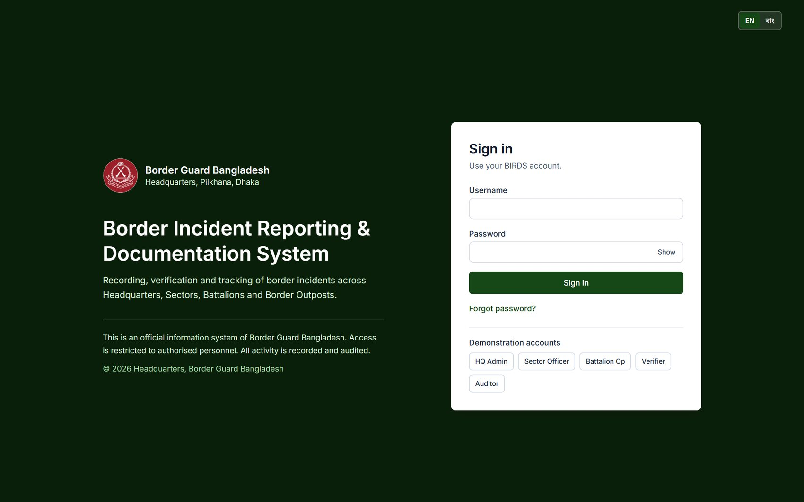
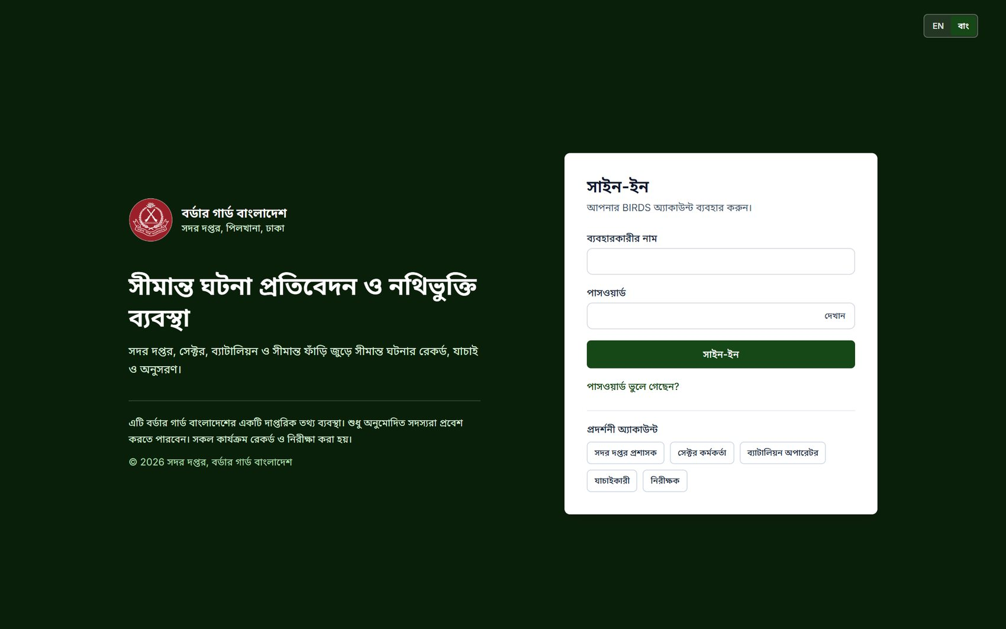
Secure sign-in, in English or Bangla
Username and password over HTTPS; the language is chosen on the first screen
Sign-in page (English)
The same page in Bangla
#4
Authentication
Username/password sign-in; generic error messages
#27
Encryption
All traffic over HTTPS/TLS
#43
Localization
English and Bangla from the first screen
Notes:
Users sign in with username and password, always over HTTPS. The language can be switched to Bangla on this first page, and every screen after it follows.
Passwords are never stored, only a bcrypt hash. Error messages are generic, so they never reveal whether a username exists. Repeated failures lock the account and are written to the audit trail.
Show: sign in as hq_admin / Admin@123; switch the language with the EN / বাংলা switch.
If asked: directory (AD/LDAP) sign-in is configured at deployment once BGB provides the directory details; the settings page is ready (item 32).

Slide 11
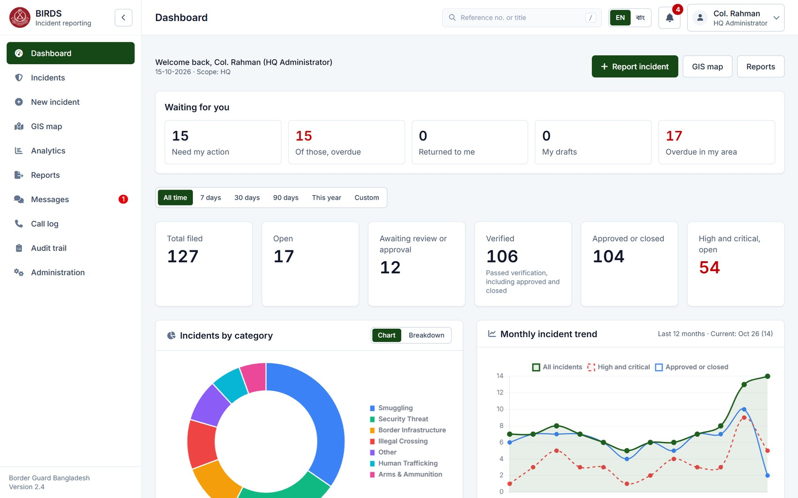
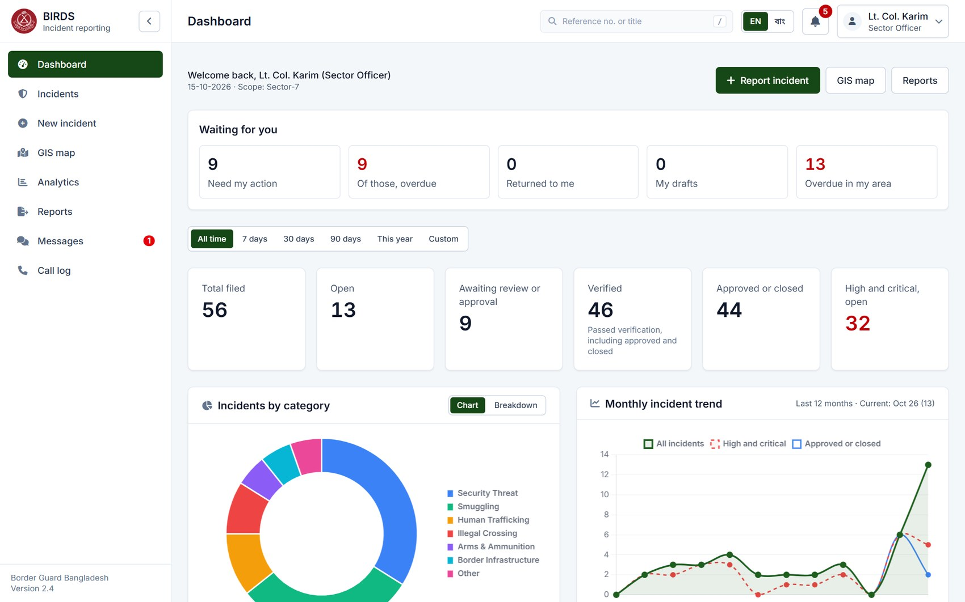
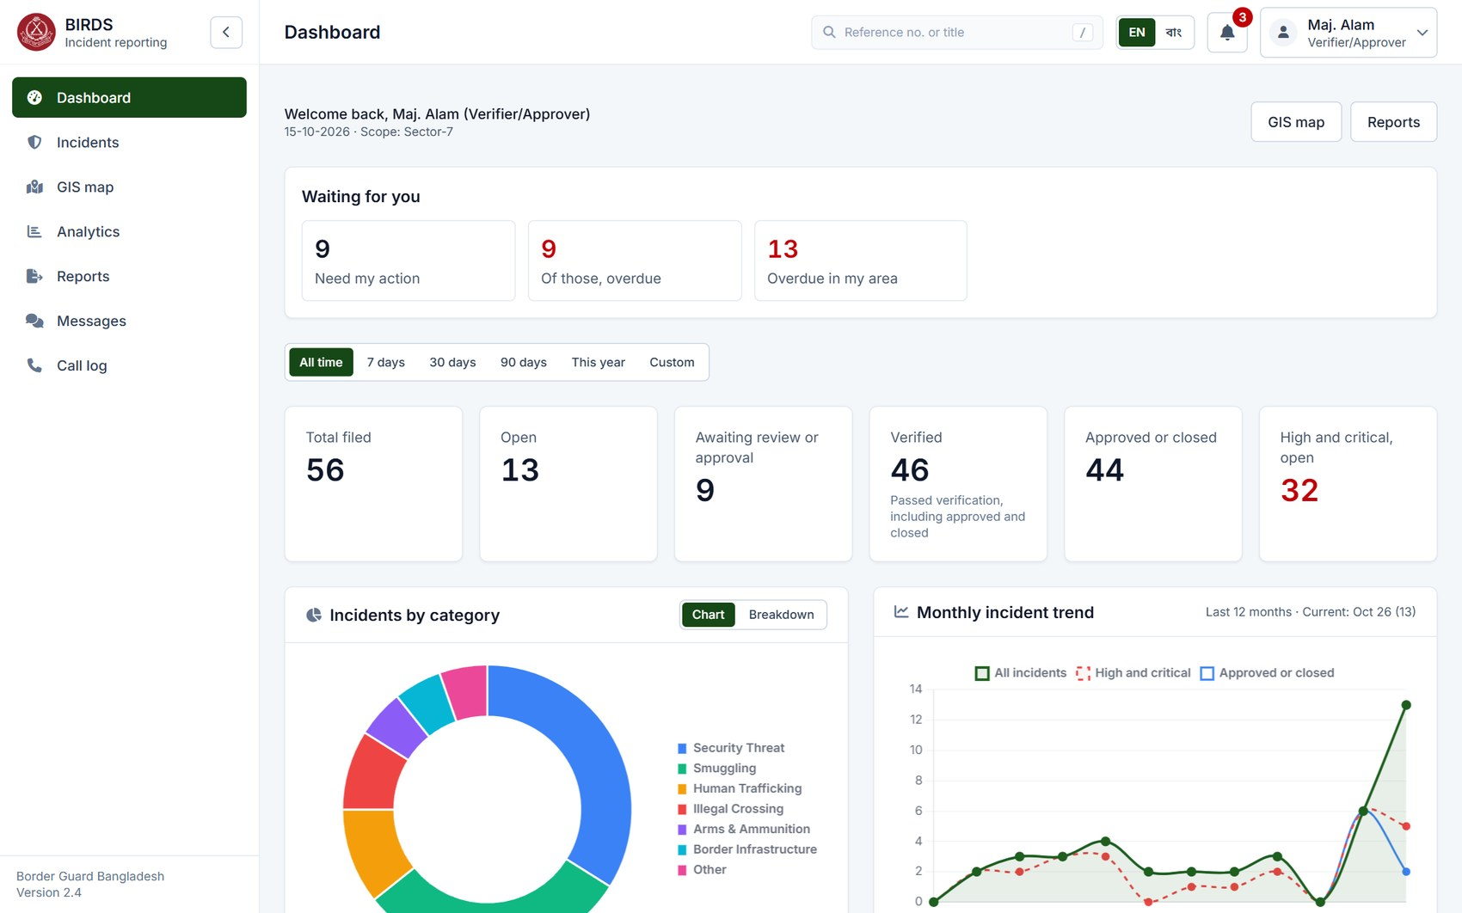
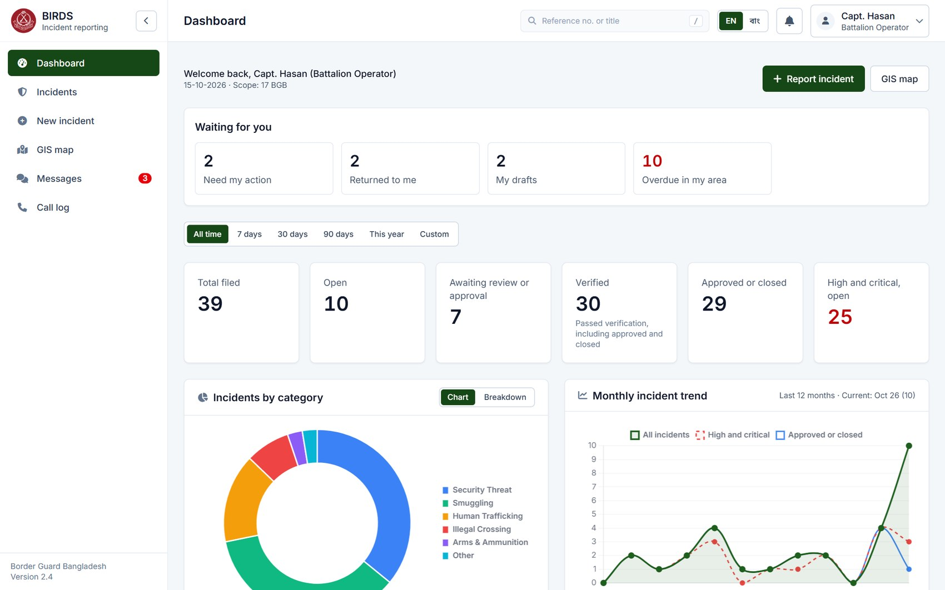
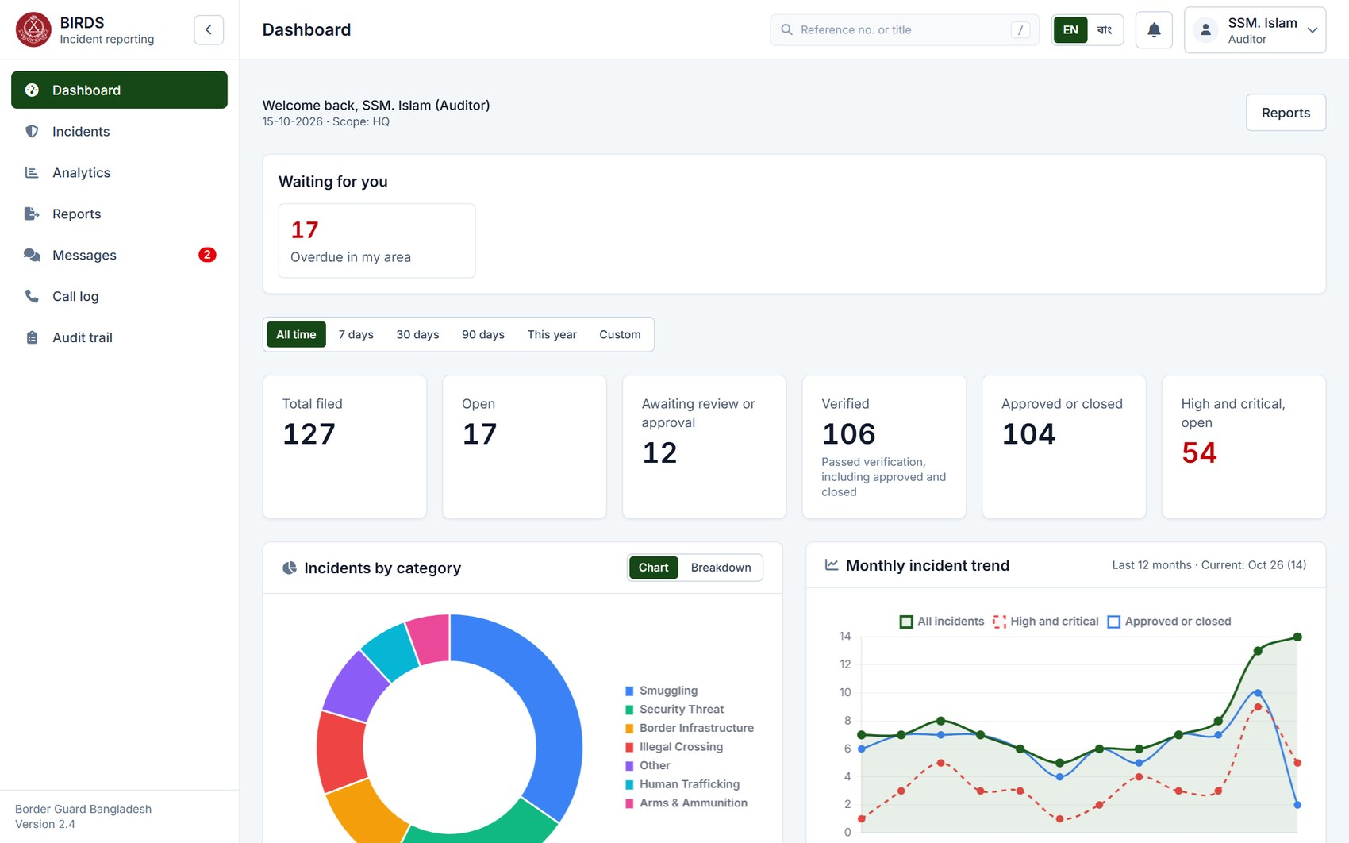
One system, five roles
Each officer sees the pages, units and actions of their role and scope; figures are those of their own area
HQ Administrator · whole country
Sector Officer · Sector-7
Verifier/Approver · Sector-7
#3
User Management
Roles with configurable access scopes
#17
Dashboard
Role-based dashboard
#26
Data Security
Access limited by role and unit
Battalion Operator · 17 BGB
Auditor · read-only, HQ
Notes:
The same dashboard for five officers. Col. Rahman at HQ sees the whole country: 127 filed incidents. Capt. Hasan, a battalion operator of 17 BGB, sees only his battalion: 39. The Sector-7 officer and the Sector-7 verifier see their sector.
The menu also differs: the battalion operator has no Analytics, Reports, Audit or Administration; the auditor has no "New incident". This comes from the permission matrix, and the server enforces it on every request, not just by hiding buttons.
Show: sign in as batt_op / Batt@123 and as hq_admin; compare the menu and the totals.

Slide 12
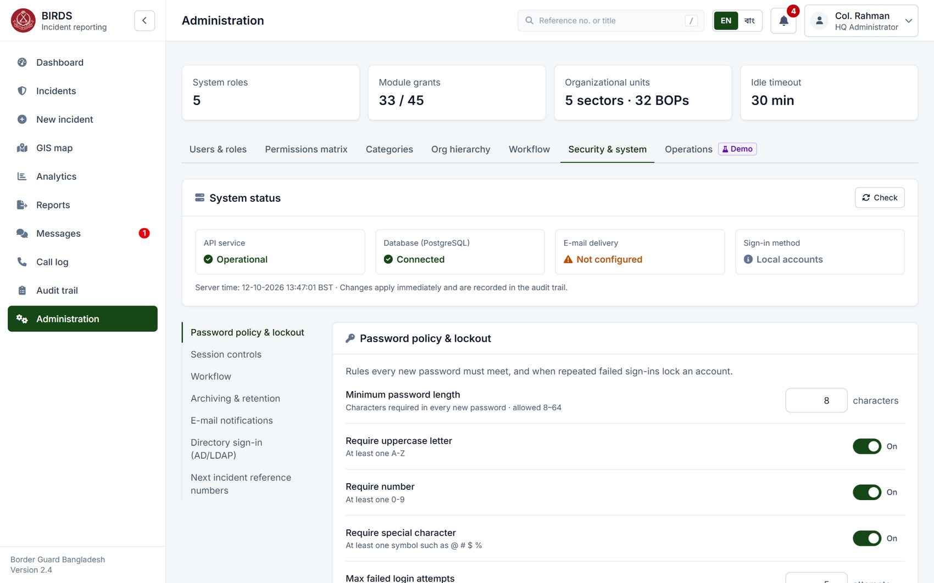
Security & system: status first
Administration › Security & system: system status, then every security setting in one column
Requirements shown
#46
Administrative Module
Administrative module for security settings
#48
Logging & Monitoring
Service status at a glance
#47
Configuration
Changed without code; changes are audited
Notes:
The Security and system page opens with the status of the system: the API service, the database, e-mail delivery and the sign-in method, each stated in words with an icon.
Below it, every security setting is grouped into sections, with a section menu on the left. Each change applies at once and is recorded in the audit trail with the old and new value.
Show: Administration › Security & system (hq_admin).
If asked: e-mail shows "Not configured" in the demo because no SMTP server is connected; in-app notifications work regardless.

Slide 13
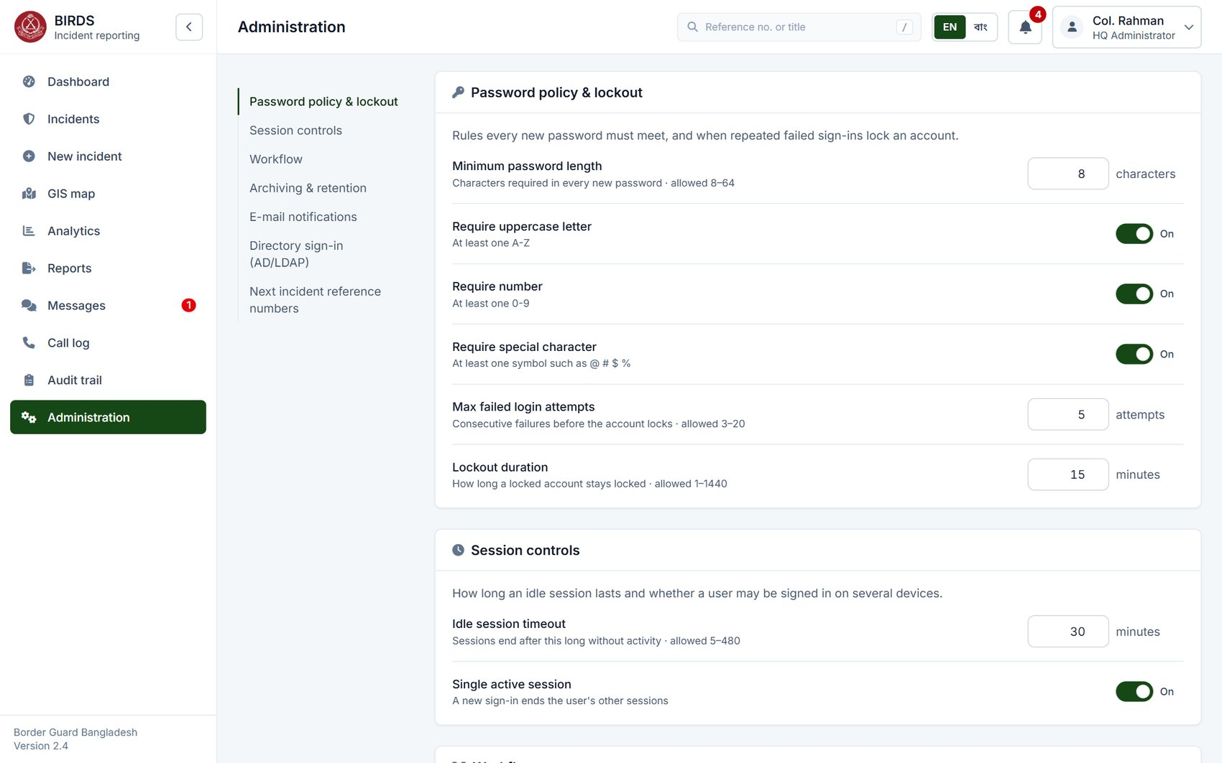
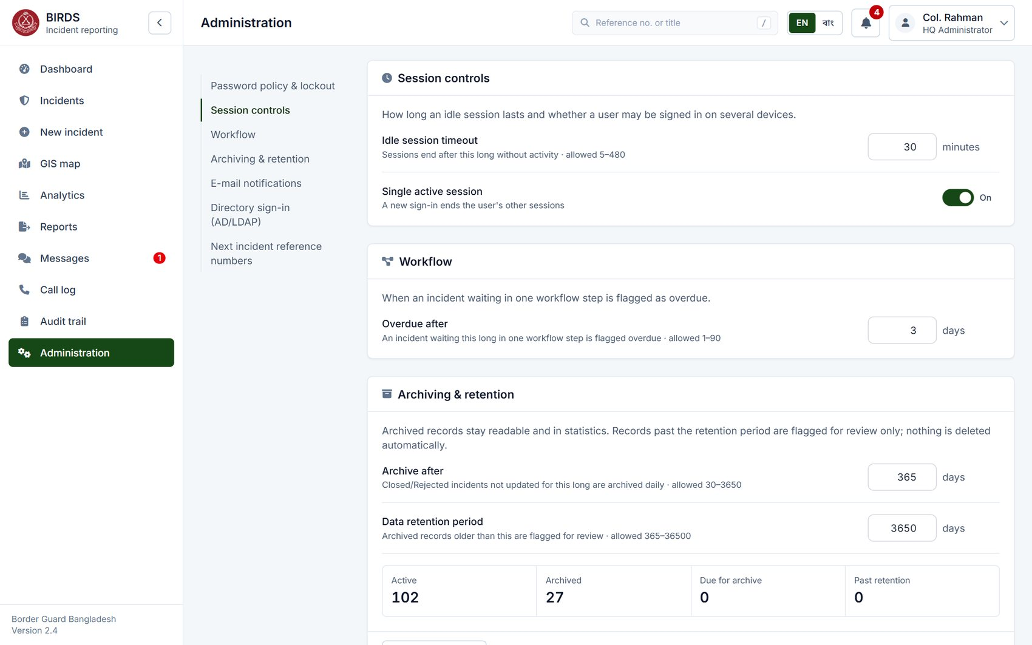
Password policy, lockout and sessions
Every value configurable, with its unit and allowed range
Password policy and lockout
Session controls, workflow, archiving
#29
Password Security
Length, complexity, failed-login threshold, lockout time
#28
Session Security
Idle timeout and single active session
#47
Configuration
No code changes
Notes:
Item 29: minimum length, uppercase, number and special character, the number of failed attempts before the account locks and how long it stays locked.
Item 28: the idle session timeout, 30 minutes here, and single active session: a new sign-in ends the user's other sessions.
Every value is checked against its allowed range by the server, for example 8 to 64 characters.
Show: change "Lockout duration" and point to the new CONFIG_CHANGE entry in the audit trail.

Slide 14
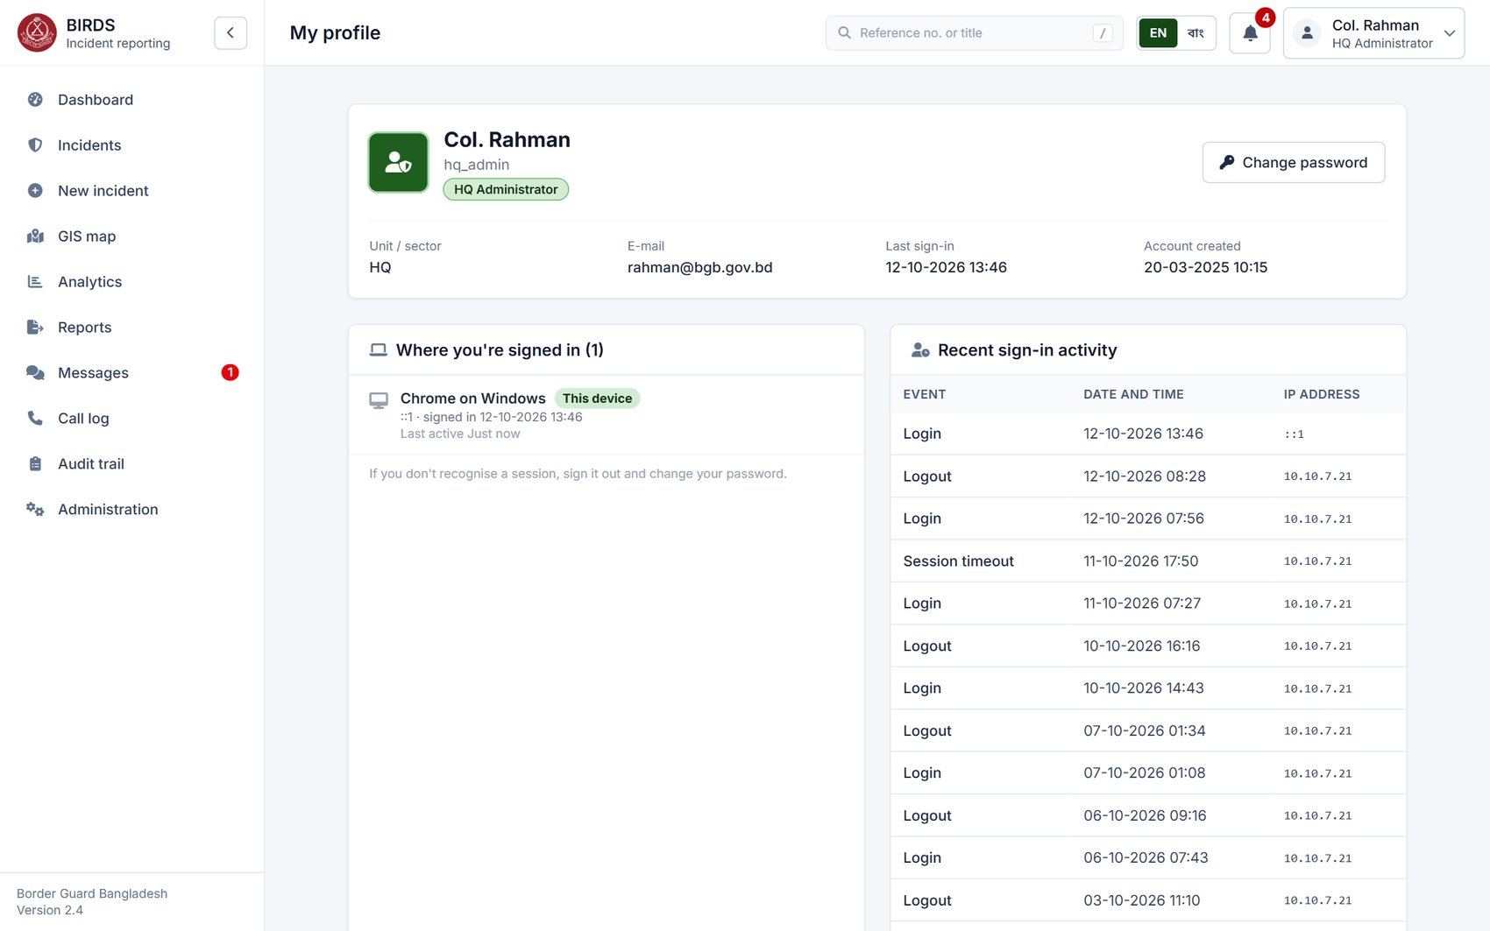
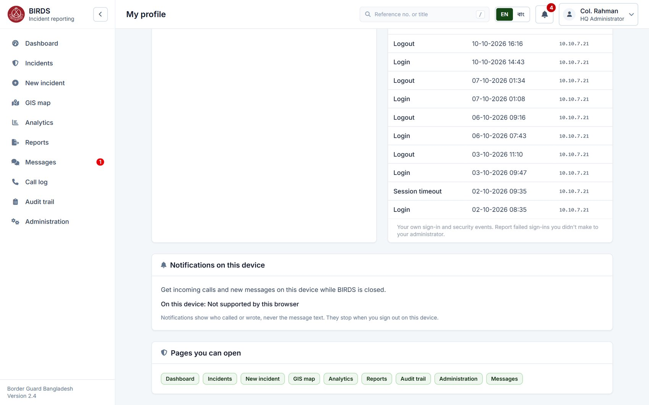
My profile: sessions and sign-in history
Each user sees where they are signed in and their own recent security events
Active sessions and recent sign-in activity
History, device notifications, pages allowed
#28
Session Security
Concurrent sessions visible and revocable
#24
Audit Trail
Sign-in and security events per user
#3
User Management
Pages the user may open, from the role
Notes:
Every user can see where they are signed in, with browser and device, and sign out other sessions. Below is their own recent activity: sign-ins, sign-outs and idle timeouts, with IP address.
This lets an officer notice a sign-in they did not make, which supports item 28 and the audit requirement.
Show: user menu › My profile (any account).

Slide 15
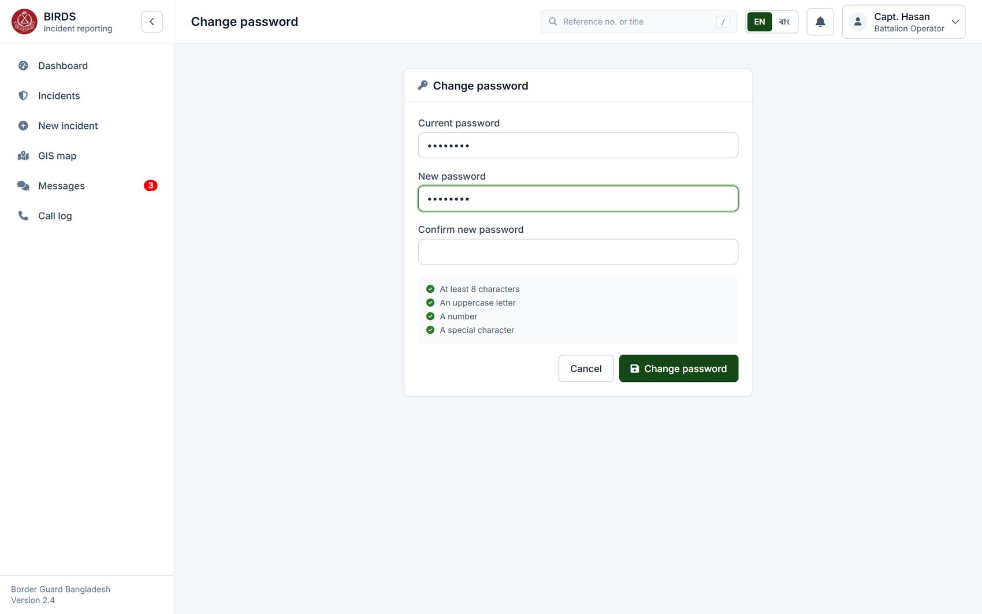
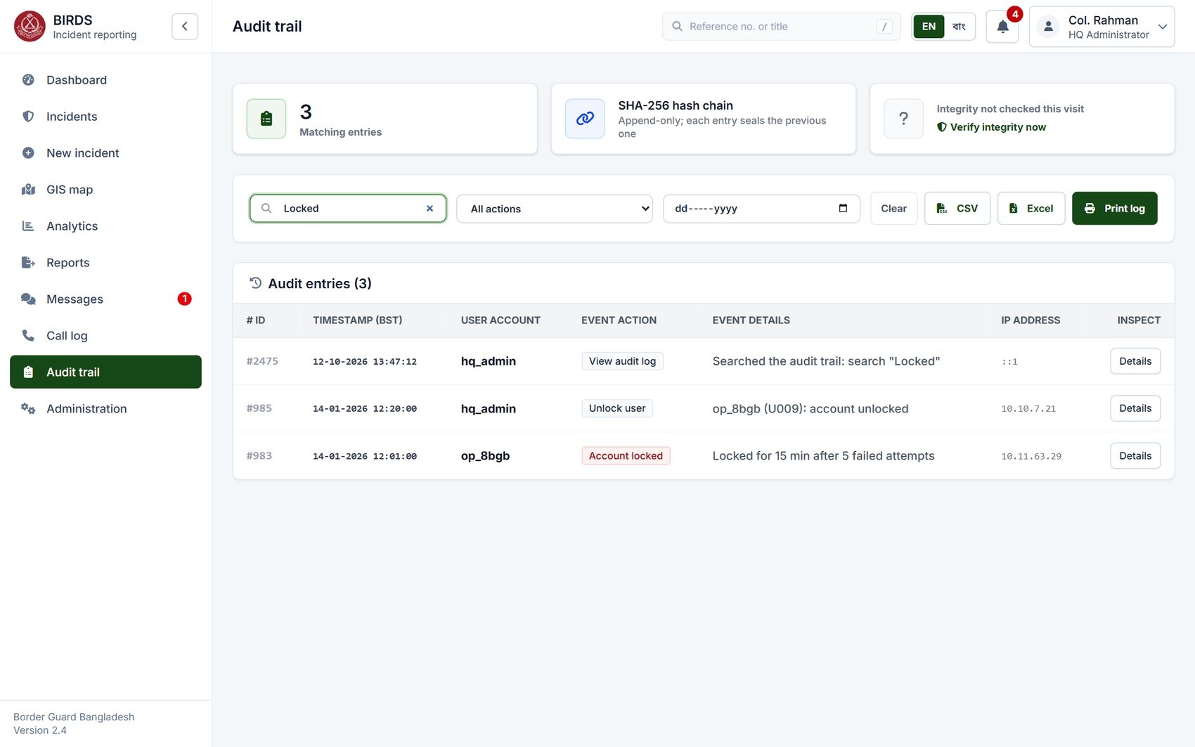
Password change and account lockout
Rules checked as the user types; lockouts are recorded and can be released by an administrator
Change password: policy shown live
Audit trail: account locked, then unlocked
#29
Password Security
Complexity enforced; lockout after failed attempts
#24
Audit Trail
Lockout and unlock recorded in the audit trail
#4
Authentication
Secure credential handling
Notes:
On the left, the password change page shows the policy and ticks each rule as the user types. After an administrator resets a password, the user must change it at the next sign-in.
On the right, the audit trail filtered for lockouts: on 14-01-2026 the 8 BGB operator was locked after five wrong passwords, and the HQ administrator unlocked the account 19 minutes later. Both events are permanent entries.
Show: Audit trail › search "Locked" (auditor or hq_admin).

Slide 16
02
Incident registration
Specification items 5–11, 15
Notes:
Section two: filing an incident, items 5 to 11 and 15. We follow Capt. Hasan, battalion operator of 17 BGB, as he files a report with GPS location, photos, a video and the seizure list.

Slide 17
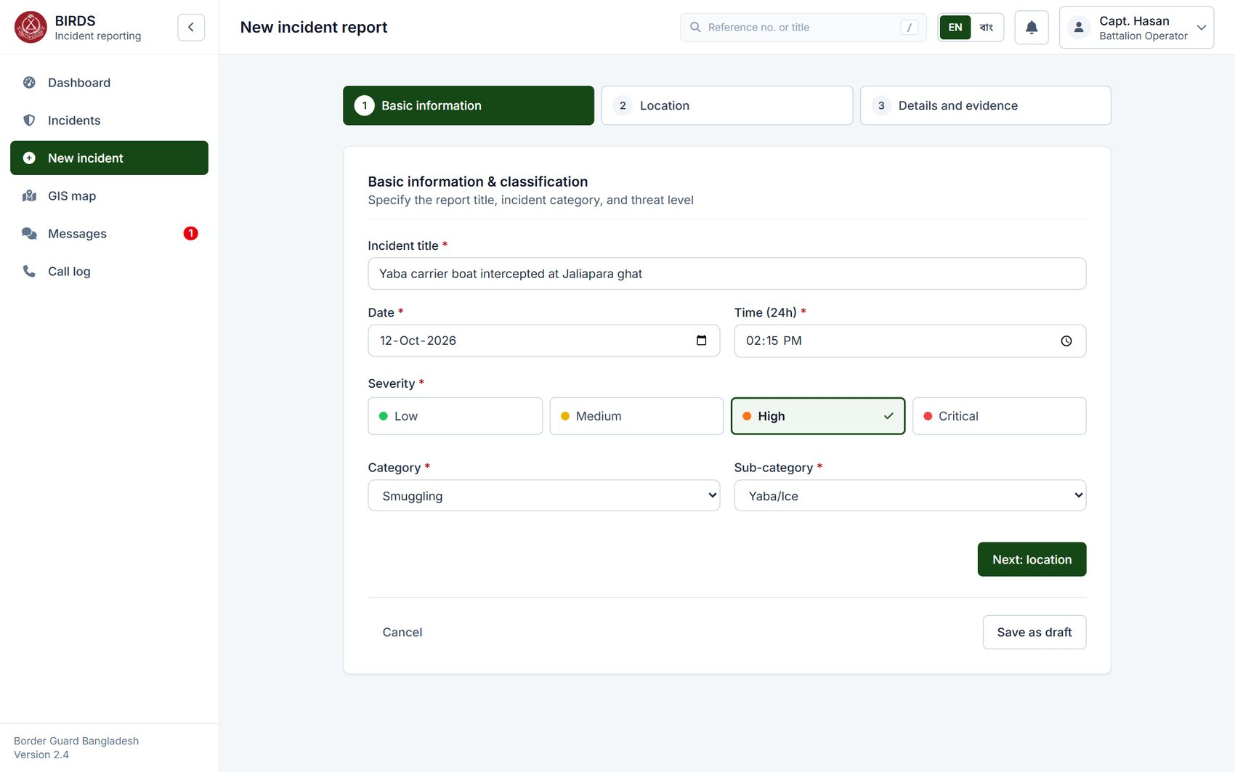
Step 1: basic information and classification
Three-step electronic form; categories, sub-categories and severity come from the configuration
Requirements shown
#5
Incident Registration
Standard electronic form: create, save draft, submit
#6
Incident Classification
Configurable category, sub-category and severity
#7
Incident Details
Title, date and time of the incident
Notes:
New incident opens a three-step form. Step one is the title, date and time, severity and the category and sub-category, here Smuggling and Yaba/Ice.
The categories are not fixed in the code: administrators add or rename them in the Admin module, item 6. The report can be saved as a draft at any step and finished later.
Show: New incident as batt_op / Batt@123.

Slide 18
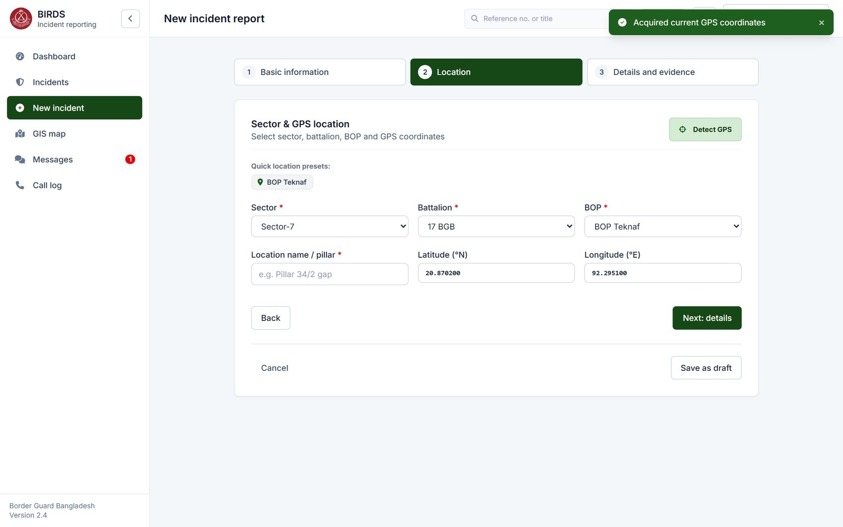
Step 2: unit and GPS location
Sector, battalion and BOP limited to the officer's own unit; GPS from the device or typed in
Requirements shown
#9
Border Sector Information
Linked to Sector / Battalion / BOP
#8
Geographical Information
GPS coordinates from "Detect GPS" or manual entry
#7
Incident Details
Location name and border area
Notes:
Step two places the incident. The officer can only choose units inside his own scope: Capt. Hasan sees 17 BGB and its BOPs, nothing else.
"Detect GPS" takes the position from the phone or laptop; it can also be typed in. The location name can be written in English and Bangla.
Show: Detect GPS on a phone shows the device position.

Slide 19
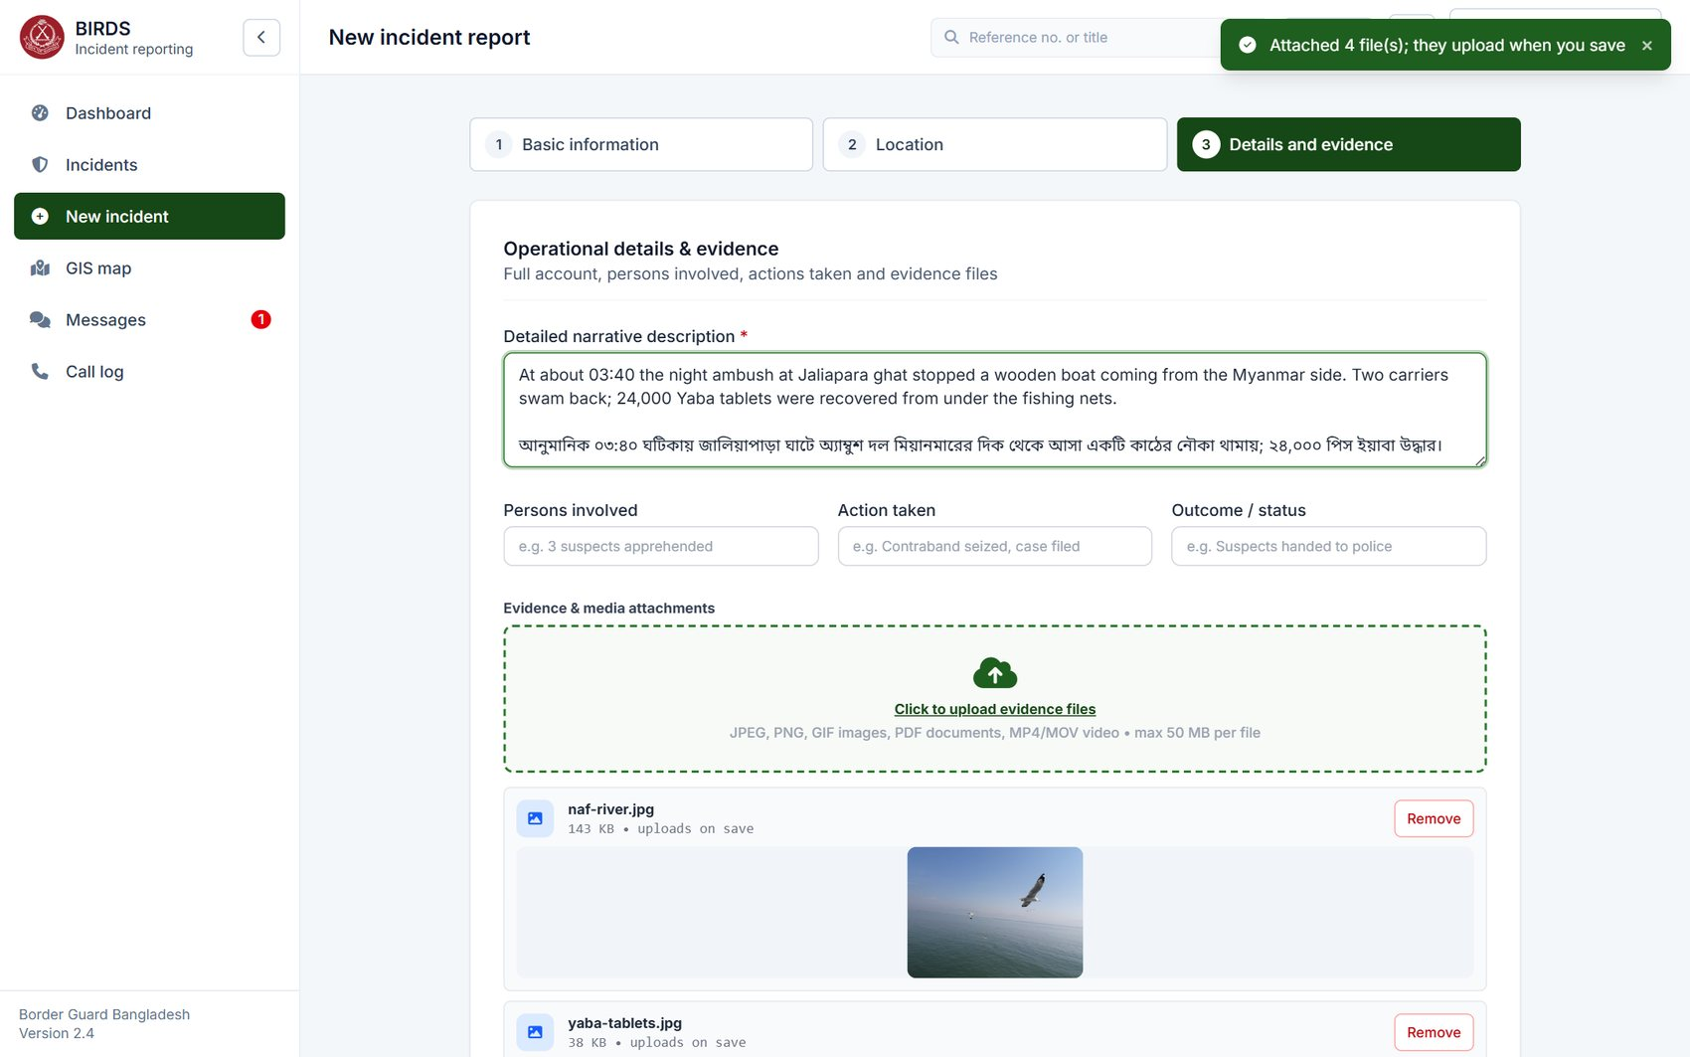
Step 3: narrative, persons, action, outcome
Full narrative in English and Bangla; persons involved, action taken and outcome
Requirements shown
#7
Incident Details
Description, persons involved, action taken, outcome
#43
Localization
Bangla and English text stored as entered
#10
Evidence & Document Management
Evidence attached in the same step
Notes:
Step three is the narrative and the operational details: persons involved, action taken and outcome. Text can be written in Bangla, English or both, as here; it is stored and printed exactly as entered.
Evidence files are attached in the same step.

Slide 20
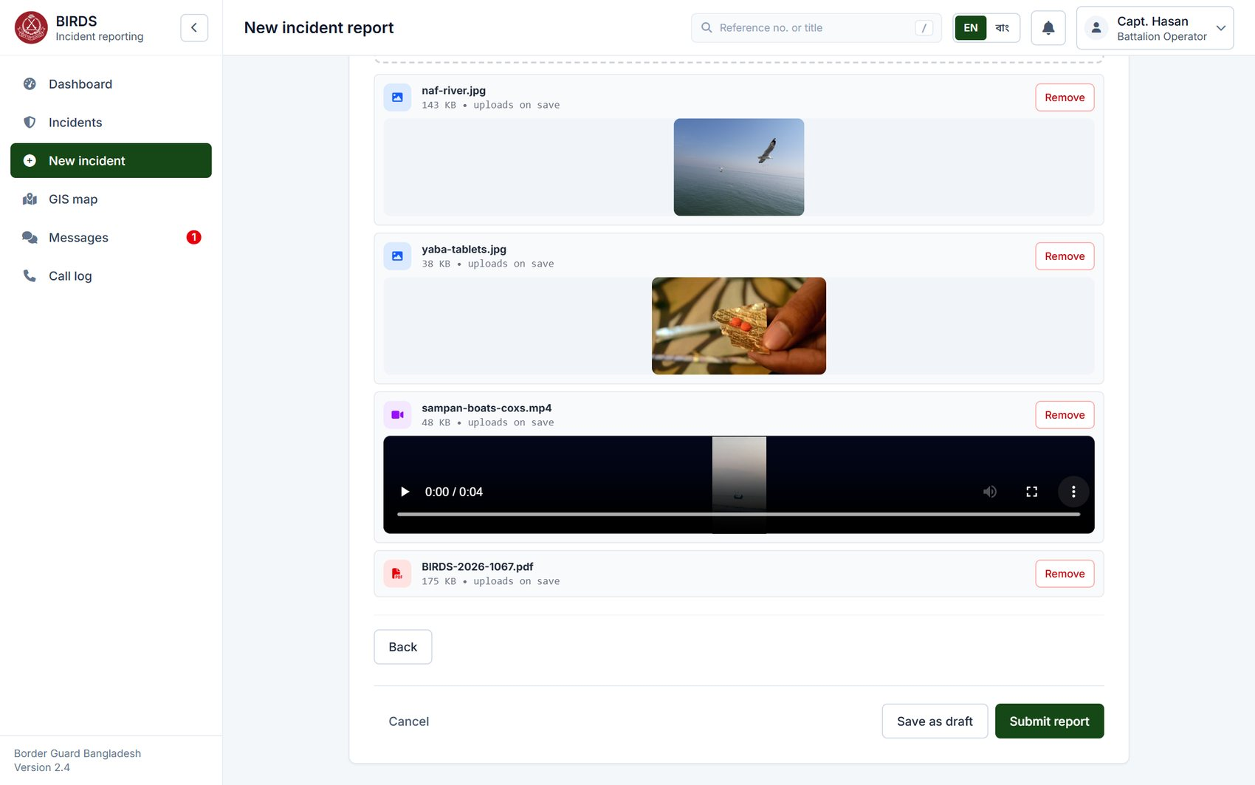
Evidence attached before submission
Photos, video and PDF shown from the officer's own copy before they are uploaded
Requirements shown
#10
Evidence & Document Management
Photographs, videos, PDFs and scanned documents
#11
Media Metadata
Metadata kept with each file
#5
Incident Registration
Save as draft or submit the report
Notes:
Here four files are attached: two photographs, a video and the seizure list as a PDF. They show in place before anything is uploaded, so the officer can check them.
Accepted types are JPEG, PNG, GIF, PDF, MP4, MOV and office documents (Word, Excel, PowerPoint, OpenDocument, RTF), up to 50 MB each. The server checks the real content of each file, not just its name, and stores it encrypted.
Show: drag files onto the drop area.

Slide 21
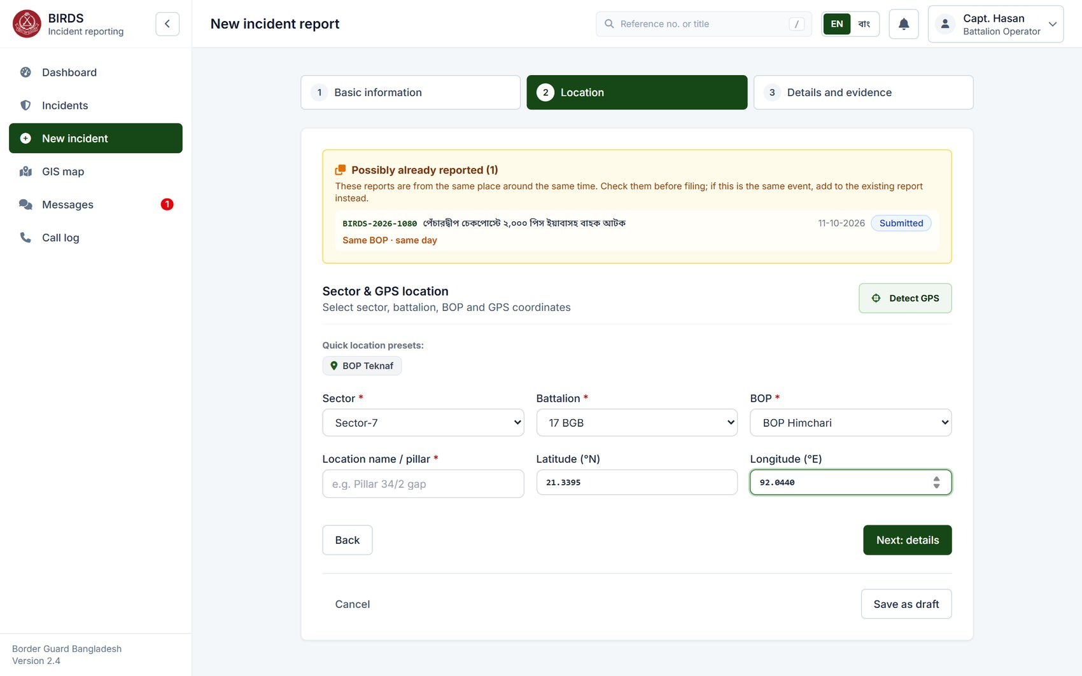
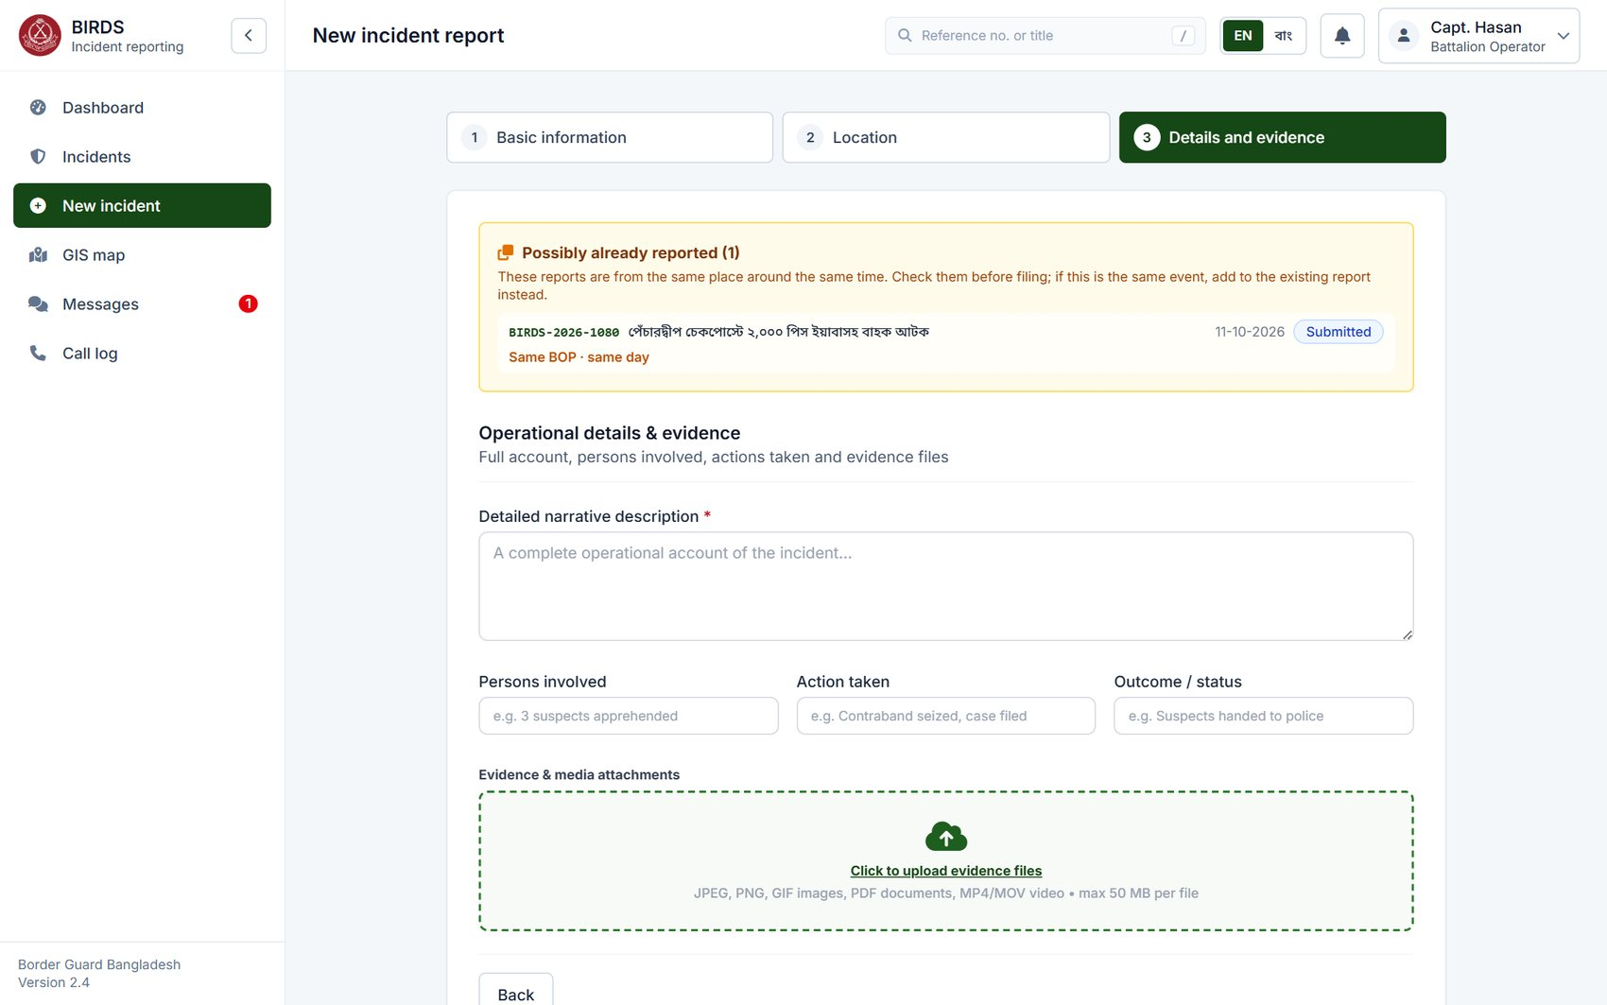
Possible duplicate: warned before filing
Reports from the same place on the same day are shown while the form is filled
Warning appears as soon as the place is chosen
It stays visible in the details step
#5
Incident Registration
Data entry with checks before submission
#25
Data Integrity
Reduces double reporting of one event
#16
Search Facility
Similar incidents found automatically
Notes:
While filing, BIRDS looks for incidents reported nearby on the same day or the day before: here the same BOP Himchari and category as BIRDS-2026-1080. The warning names that report so the officer can open it and, if it is the same event, add to it instead of filing again.
It is advice only; the officer can still file. This is one of our value additions.

Slide 22
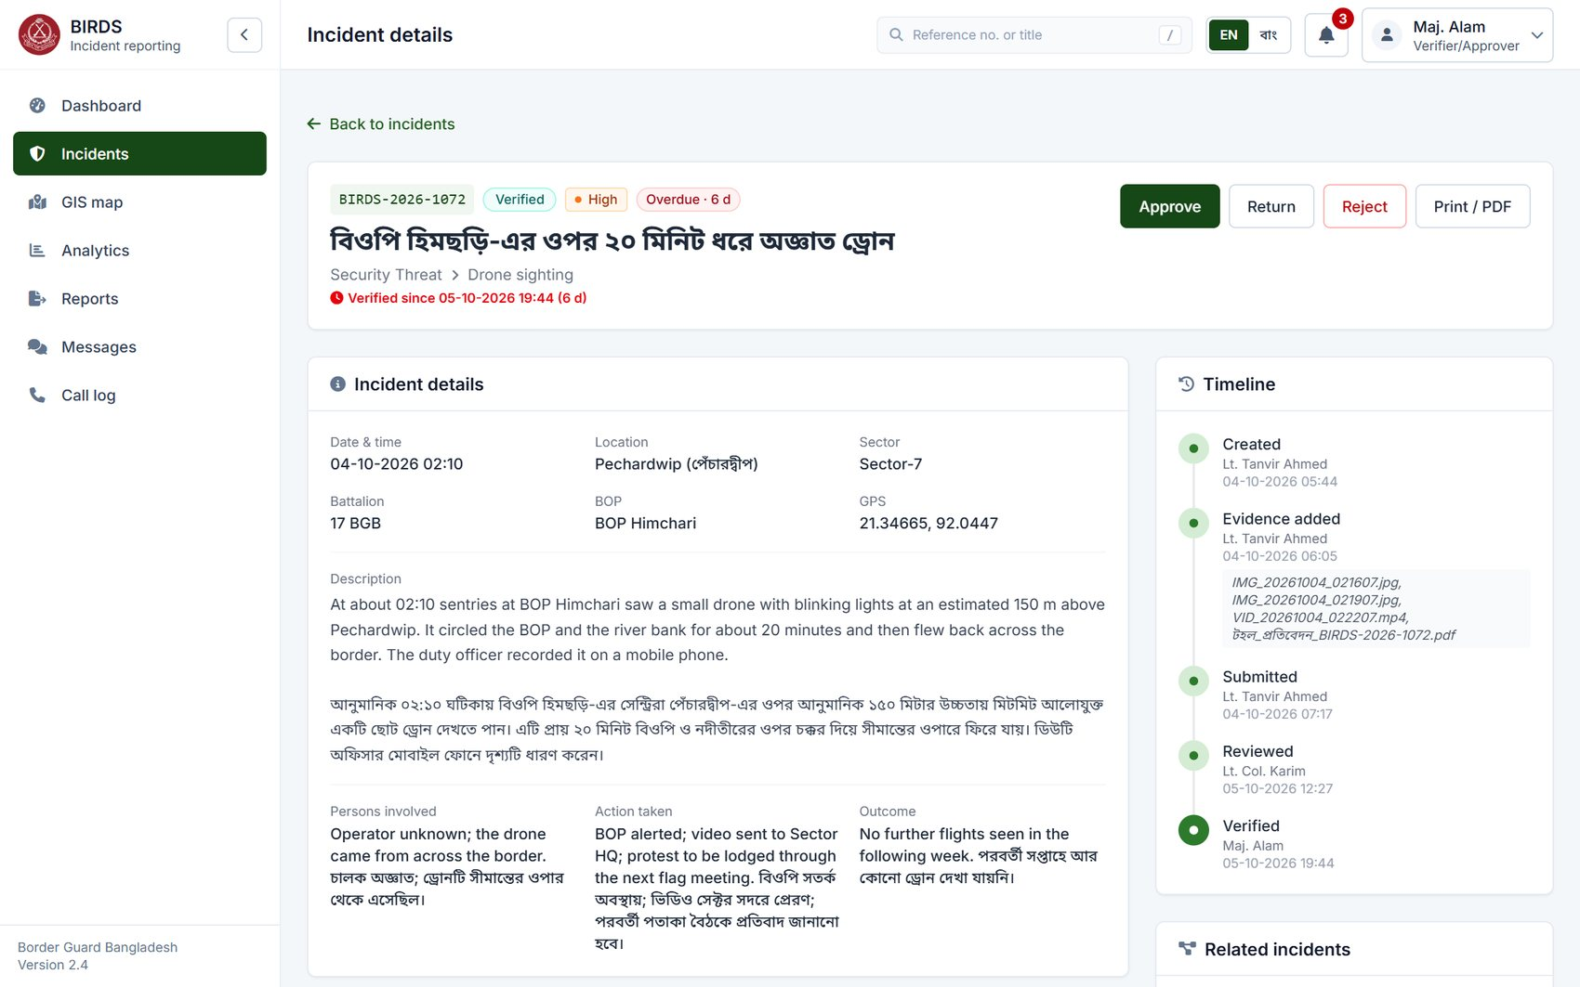
The incident record
Unique reference, status, severity, overdue flag, all details, timeline and the actions allowed now
Requirements shown
#15
Incident Tracking
Unique number BIRDS-<year>-NNNN
#7
Incident Details
All captured details in one view
#12
Incident Timeline
Chronological timeline
#43
Localization
Bangla title and narrative
Notes:
This is BIRDS-2026-1072: an unidentified drone over BOP Himchari, with a Bangla title. At the top: the unique reference number, status Verified, severity High, and the red flag "Overdue · 6 d" because it has waited six days in this step.
The narrative is in English and Bangla. On the right, the timeline. The buttons at the top are the actions this user may take now: Maj. Alam, the verifier, sees Approve, Return and Reject.
Show: open BIRDS-2026-1072 as verifier / Verify@123.

Slide 23
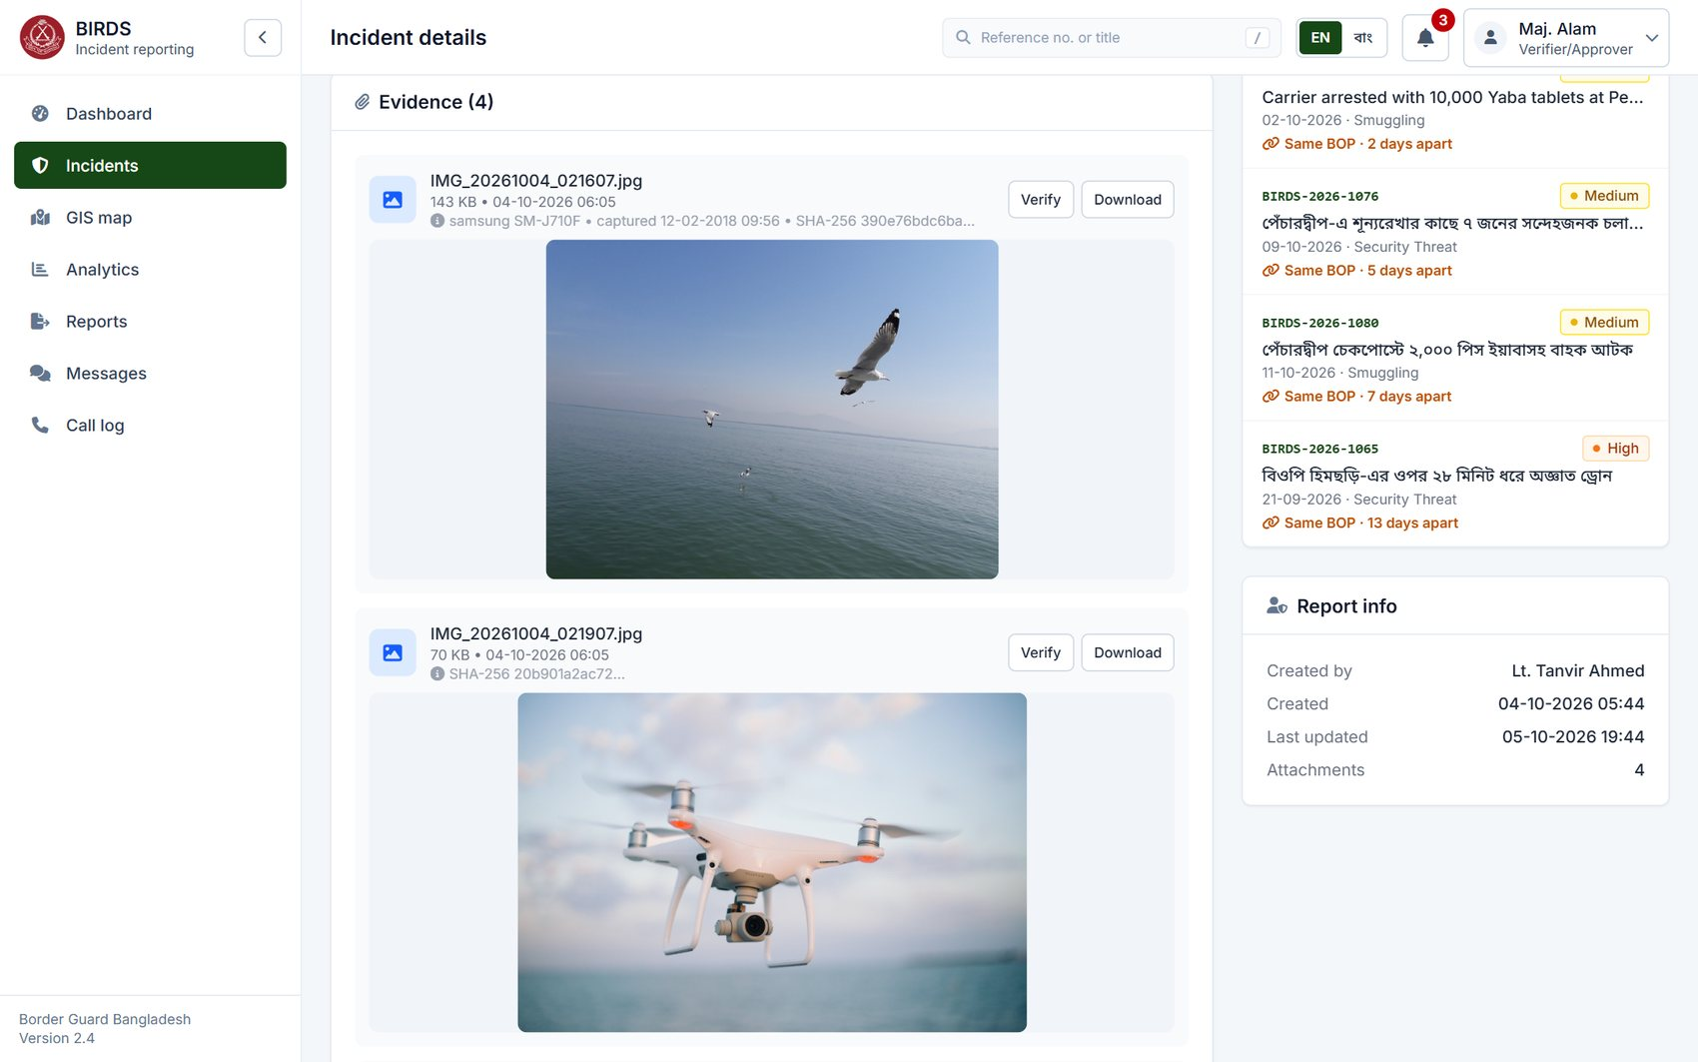
Evidence with its metadata preserved
Photos shown in place with camera, capture time, size and SHA-256 fingerprint
Requirements shown
#10
Evidence & Document Management
Evidence stored against the incident
#11
Media Metadata
EXIF camera and date, file size, upload time, SHA-256
#8
Geographical Information
Related incidents nearby, on the right
Notes:
Evidence opens in place. Under each file: name, size, upload time and, for photographs, the camera and capture time read from the file's own EXIF data, here a Samsung phone. Each file also has a SHA-256 fingerprint taken at upload.
On the right, related incidents: other reports at the same BOP or within 5 km in the 30 days before and after.
If asked: the demo photographs are freely licensed pictures of real border places; their EXIF is their own, so capture dates differ from the fictional incident dates.

Slide 24
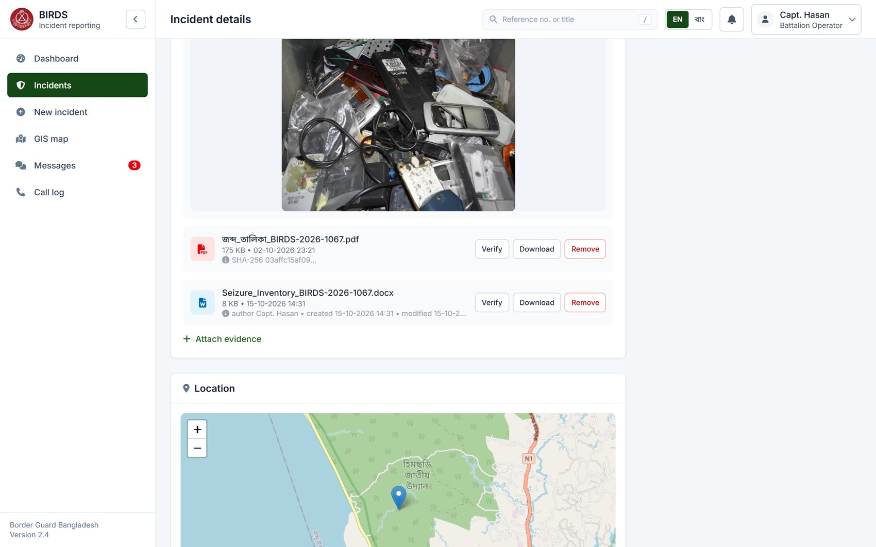
Reports and office documents as evidence
Word, Excel, PowerPoint, OpenDocument and RTF files, with their author and dates; macro-enabled files refused
Requirements shown
#10
Evidence & Document Management
Reports and other documents attached
#11
Media Metadata
Document author, created and modified kept
#49
Security Hardening
Type checked on the content; macros refused
Notes:
Besides photos, videos and PDFs, officers attach reports and other documents: Word, Excel and PowerPoint in current and older formats, OpenDocument and RTF. Here the BOP's seizure inventory as a Word file.
Under the file: the author and the created and modified dates, read from the document's own properties, next to its SHA-256 fingerprint. The file type is decided from the content, not the name, and documents that contain macros are refused.
Show: open BIRDS-2026-1067 as batt_op / Batt@123 and attach a Word or Excel file.

Slide 25
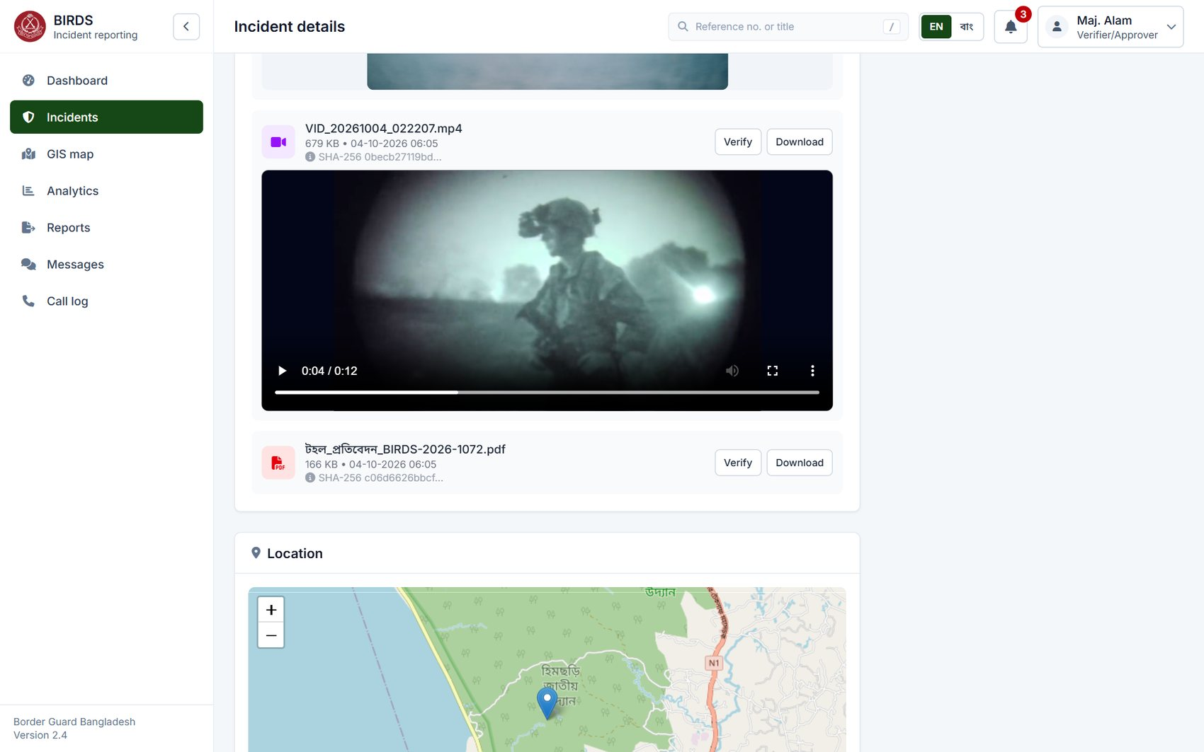
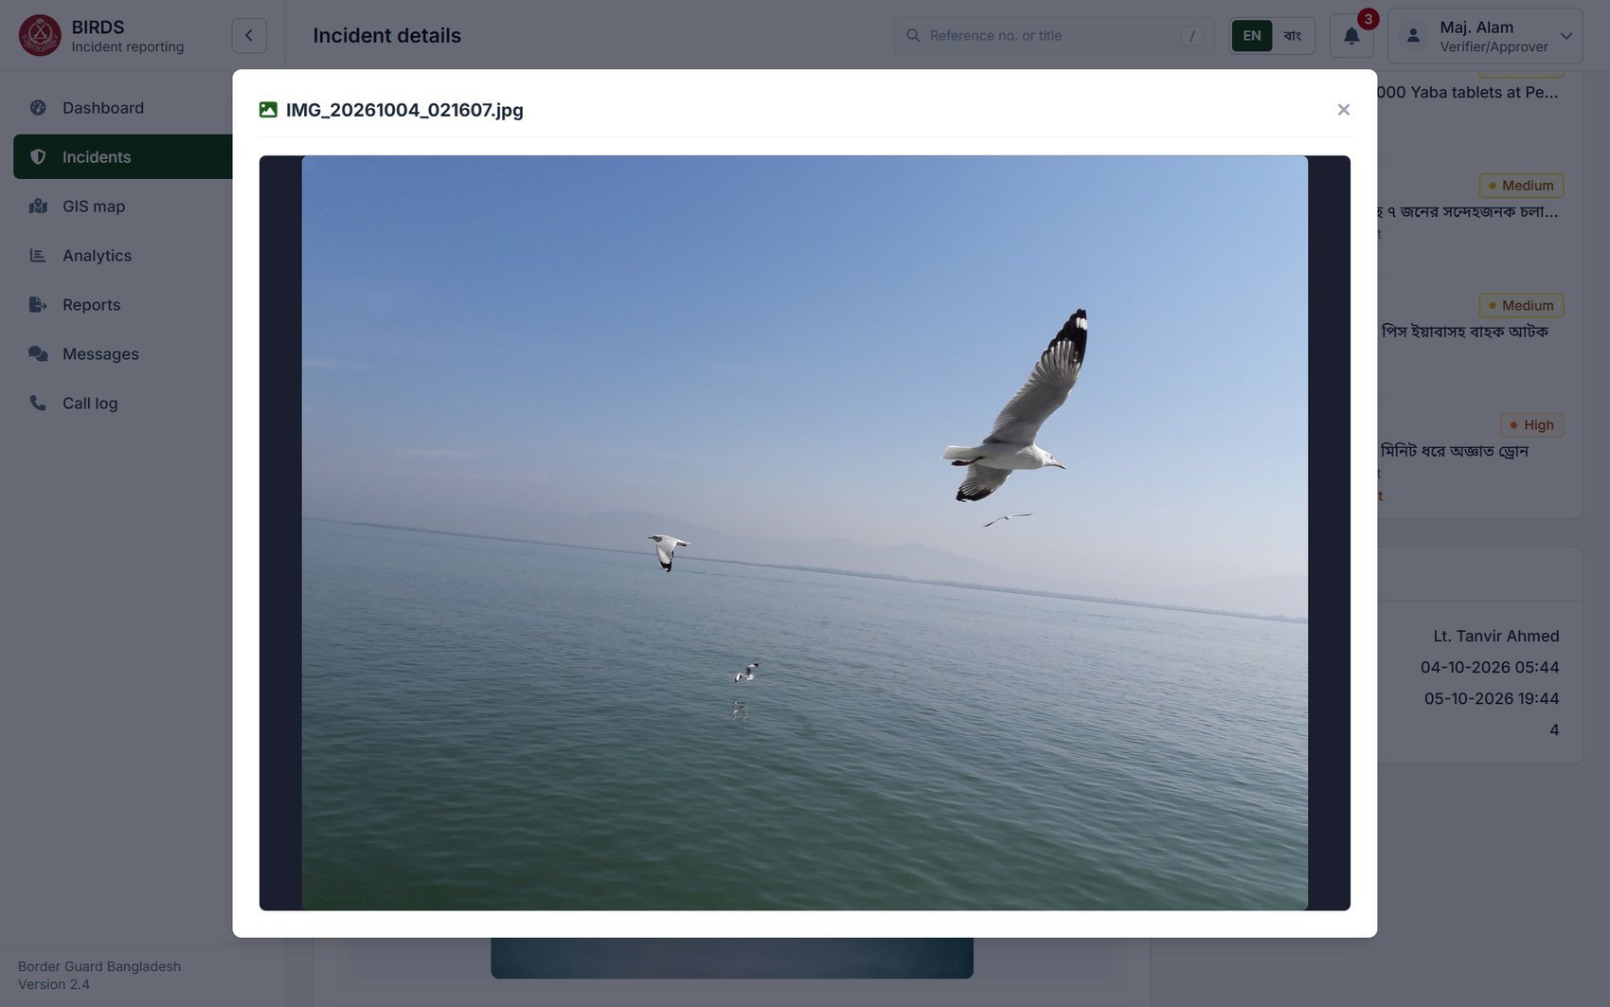
Video evidence and full-size photos
Videos play in the page; photos open full size from the copy already loaded
Night video of the drone sighting
Photo opened full size
#10
Evidence & Document Management
Video evidence stored and played
#11
Media Metadata
Original file kept unchanged
#24
Audit Trail
Each view of evidence audited
Notes:
Video evidence plays inside the page, here the night recording of the drone. Photos open full size with one click.
Every file is fetched with the user's access token, decrypted on the server and checked; opening evidence is recorded in the audit trail.

Slide 26
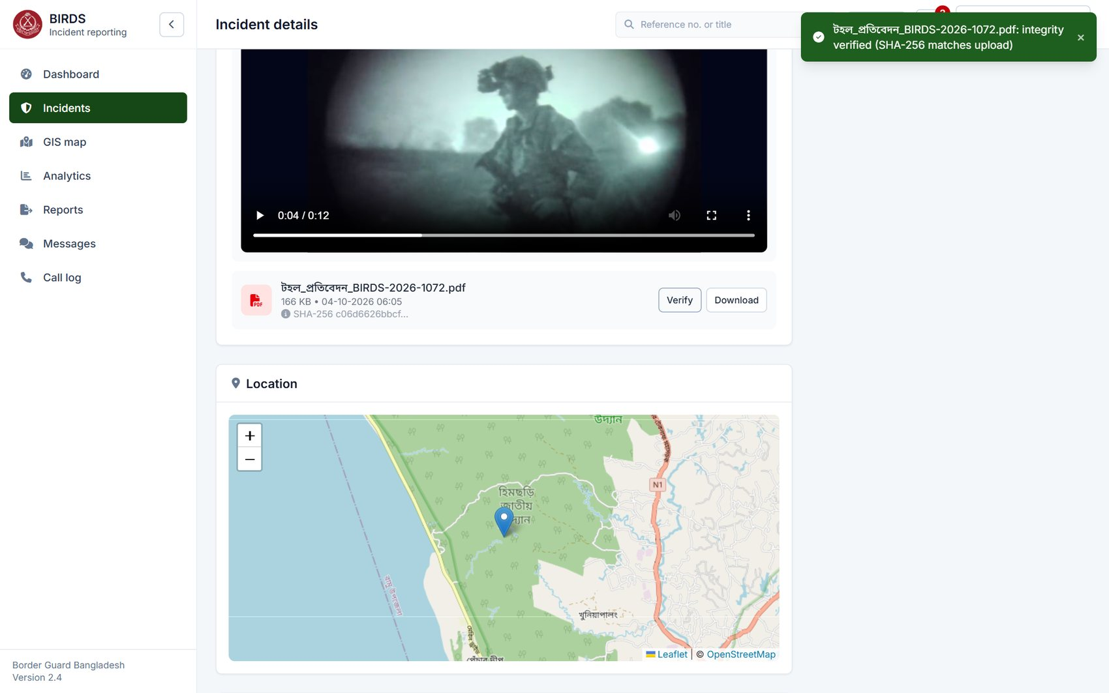
Integrity check: the file is unchanged
Verify re-reads the stored file and compares it with the fingerprint taken at upload
Requirements shown
#25
Data Integrity
Proves evidence was not altered
#11
Media Metadata
SHA-256 fingerprint kept with each file
#27
Encryption
Files encrypted at rest (AES-256-GCM)
Notes:
Verify re-reads the stored file, decrypts it and recomputes the SHA-256 fingerprint. The message confirms it matches the one taken at upload, so the file is exactly as filed.
If a stored file had been altered, decryption fails and BIRDS refuses to serve it, records the attempt and says so plainly. This supports chain of custody for court cases.
Show: Verify on any evidence file.

Slide 27
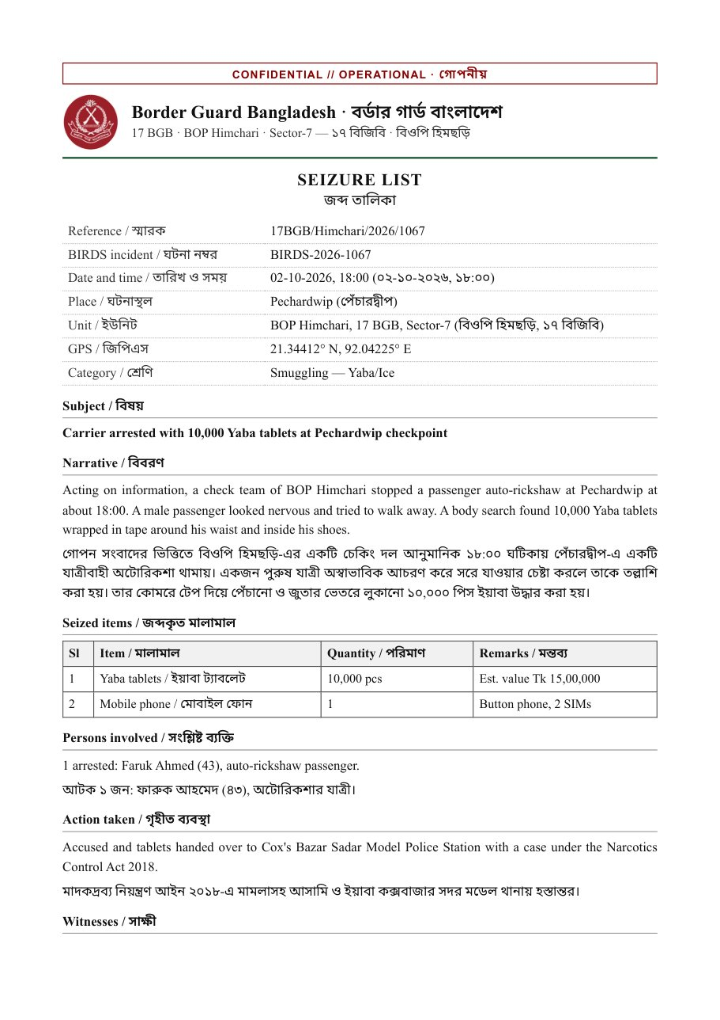
Documents as evidence: the seizure list
Scanned or generated documents attached as PDF; Bangla text kept exactly
Requirements shown
#10
Evidence & Document Management
Scanned documents and PDFs attached
#43
Localization
Bangla documents kept and displayed
#11
Media Metadata
Document stored with its fingerprint
Seizure list (জব্দ তালিকা) attached to BIRDS-2026-1067
Notes:
Every demo incident carries a document such as this seizure list: crest, classification, unit and incident reference, the seized items with quantity and value, witnesses and signature lines, in English and Bangla.
In operation these are the officer's scanned documents; any PDF is accepted. The footer marks this one as demonstration data.

Slide 28
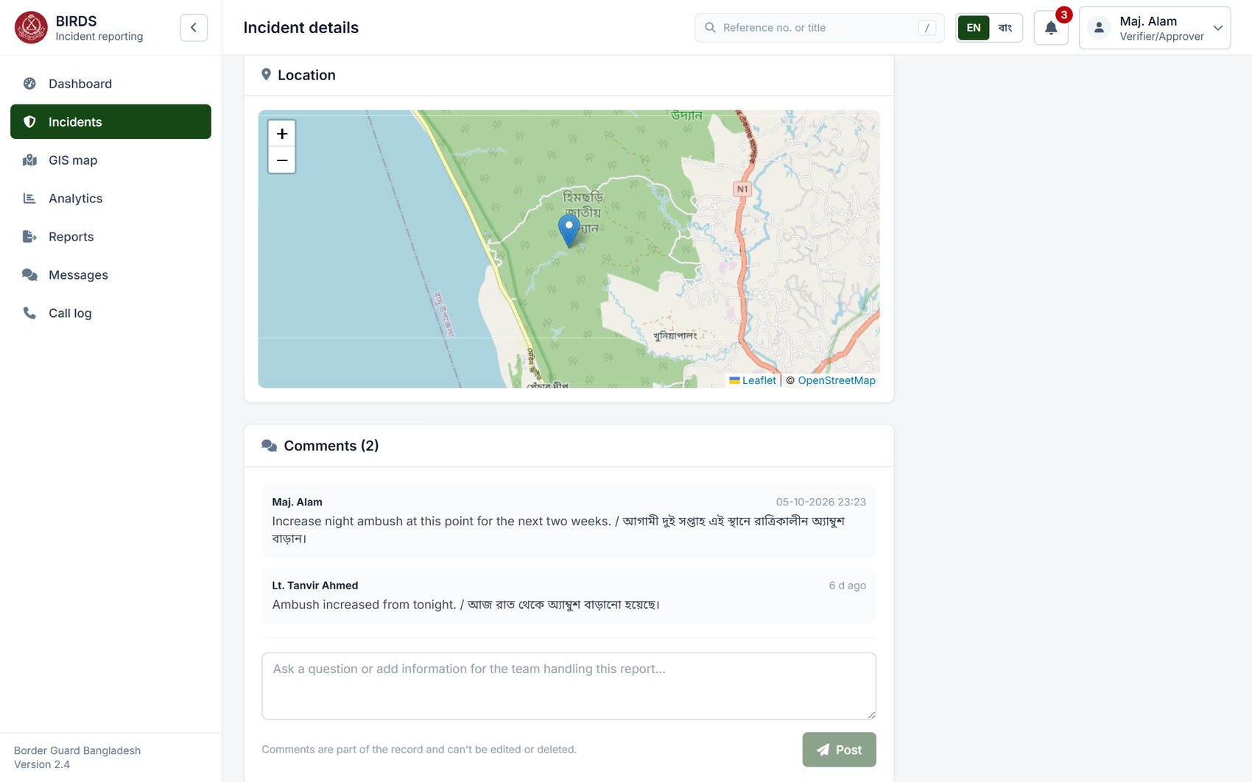
Location map and discussion
The incident on the map; comments from reviewers and the filing officer, kept on record
Requirements shown
#8
Geographical Information
Incident shown on the map
#12
Incident Timeline
Comments part of the record
#23
Notifications
Participants notified of comments
Notes:
Further down: the incident on the map, and the comments. Reviewers and the filing officer discuss the report here instead of by phone; comments are part of the record, cannot be edited or deleted, and notify the other participants.

Slide 29
03
Workflow and verification
Specification items 12–14, 23, 25
Notes:
Section three: the workflow, items 12 to 14, 23 and 25. From submission through review, verification and approval to closure, with return for correction and rejection.

Slide 30
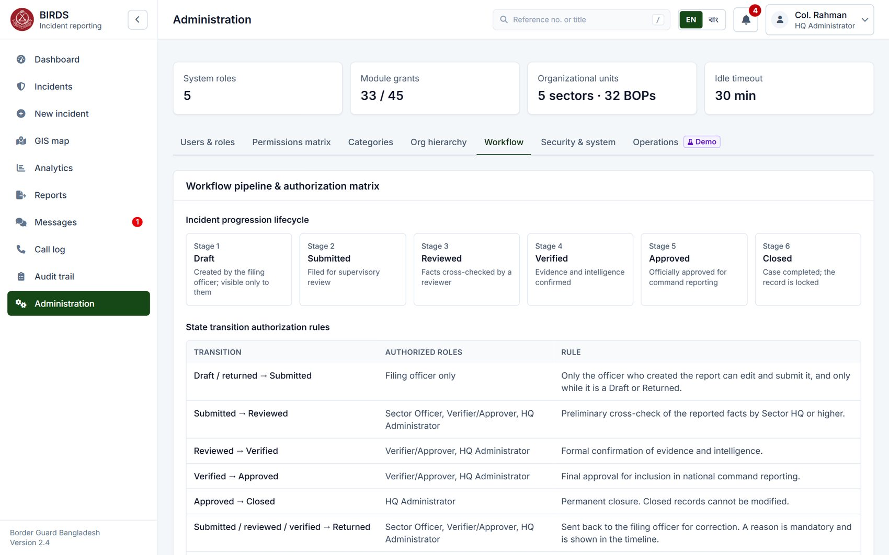
The workflow and who may act
Draft → Submitted → Reviewed → Verified → Approved → Closed, with Return and Reject
Requirements shown
#13
Workflow Management
Draft, Submitted, Reviewed, Verified, Approved, Closed
#14
Verification & Approval
Review, return, verify, approve, reject
#25
Data Integrity
Separation of duties
Notes:
This page states the workflow rules. Six stages, plus Returned and Rejected. For each transition: who may perform it and the rule that applies.
Two rules apply everywhere: an officer acts only on incidents inside their scope, and nobody can review, verify or approve a report they filed themselves. The server enforces both; the buttons only reflect them.
Show: Administration › Workflow.

Slide 31
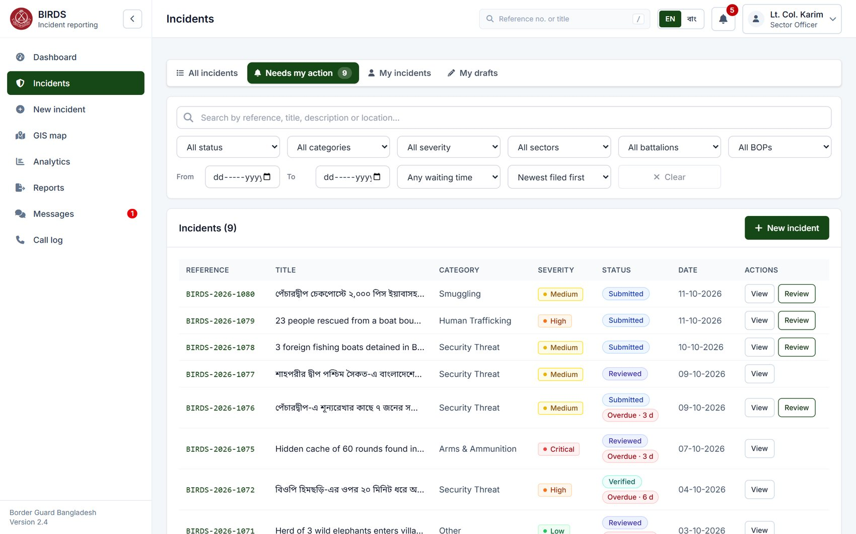
Work queue: what waits for me
"Needs my action" lists the reports this officer must act on now, with overdue flags
Requirements shown
#14
Verification & Approval
Supervisors find reports to review, verify, approve
#16
Search Facility
Views and filters for tracking
#13
Workflow Management
Overdue items flagged
Notes:
"Needs my action" is each officer's queue. For Lt. Col. Karim, the Sector-7 officer, it lists the nine reports that wait for his review, newest first. Red "Overdue" badges show which have waited longer than the configured three days. The action button sits on each row.
Show: Incidents › Needs my action as sector_off / Sector@123.

Slide 32
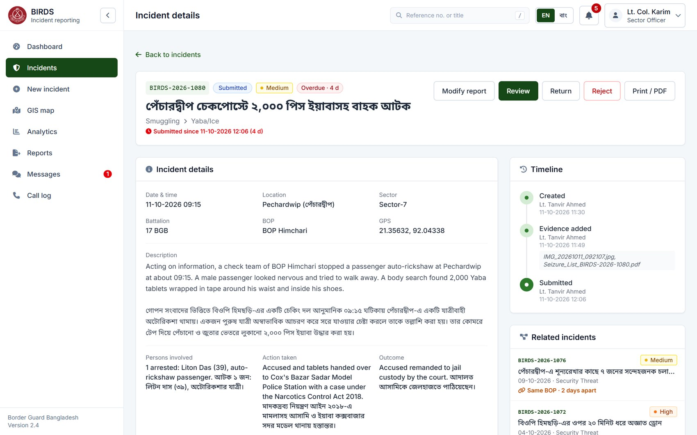
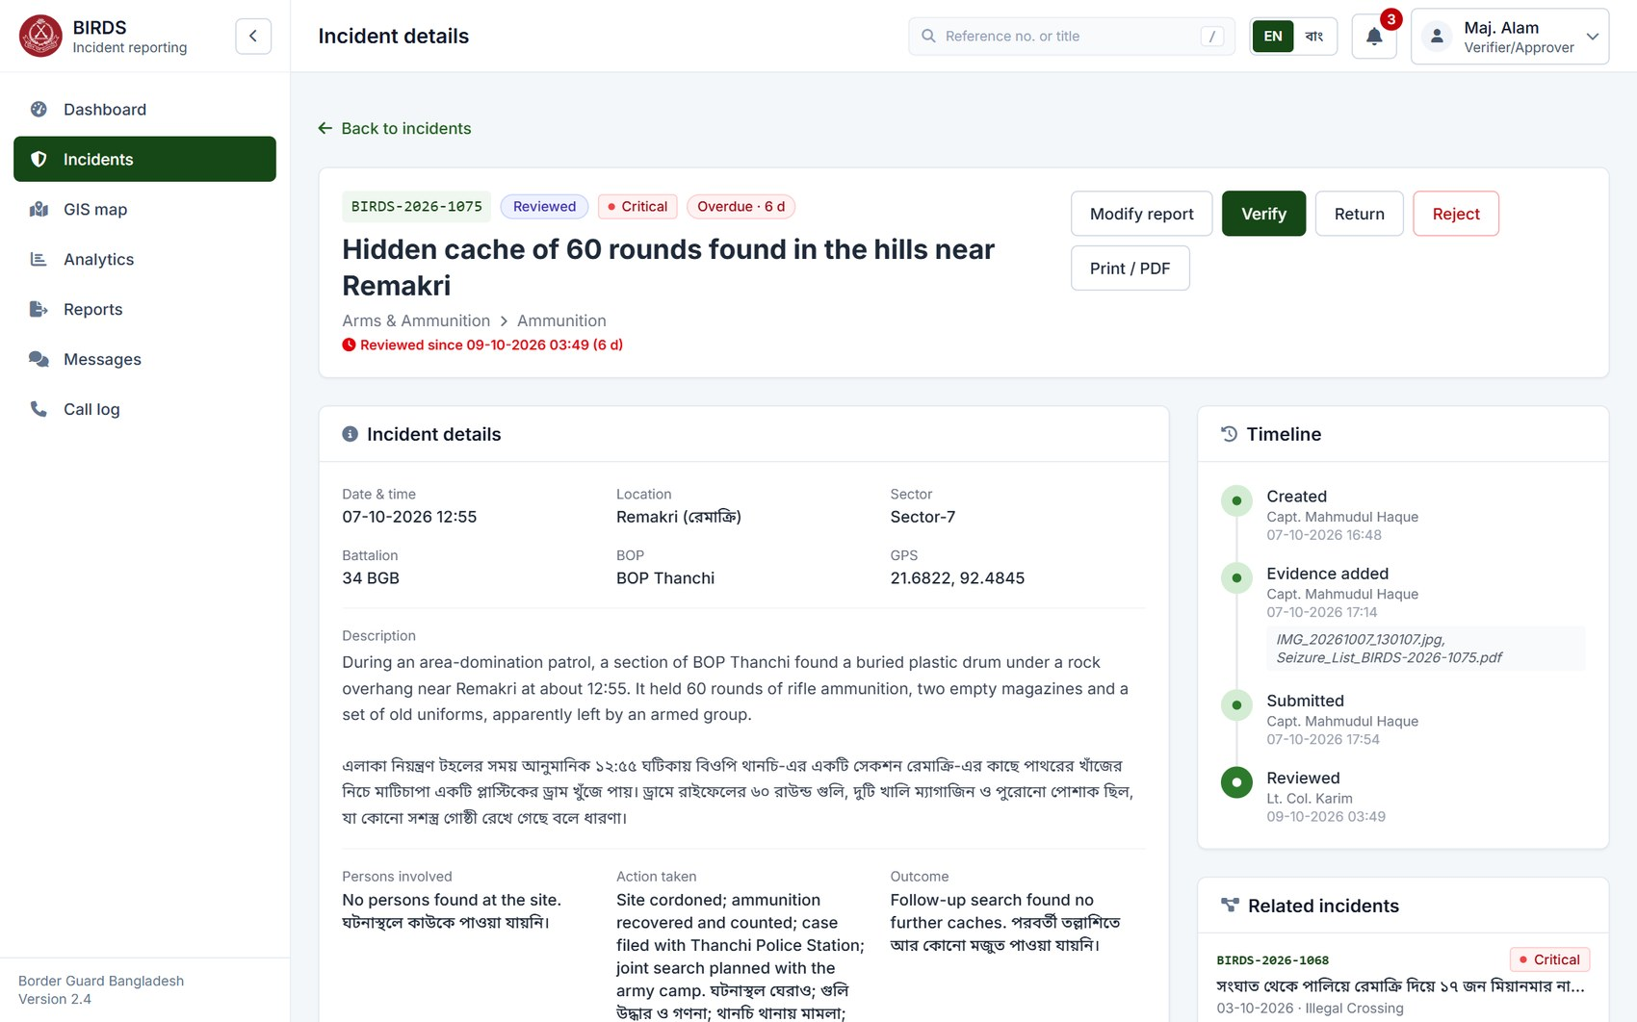
Review and verify: actions by role
The same page shows different buttons to each officer at each stage
Sector officer: Modify report, Review, Return, Reject
Verifier: Modify report, Verify, Return, Reject
#14
Verification & Approval
Supervisory review and verification
#13
Workflow Management
Only actions allowed at this stage
#3
User Management
Authority by role and scope
Notes:
On the left, a submitted report as the Sector officer sees it: Modify report, Review, Return or Reject. On the right, a reviewed report as the Verifier sees it: Modify report, Verify, Return or Reject.
There is no fixed list in the browser: the server sends the actions allowed for this user, at this stage, for this incident.

Slide 33
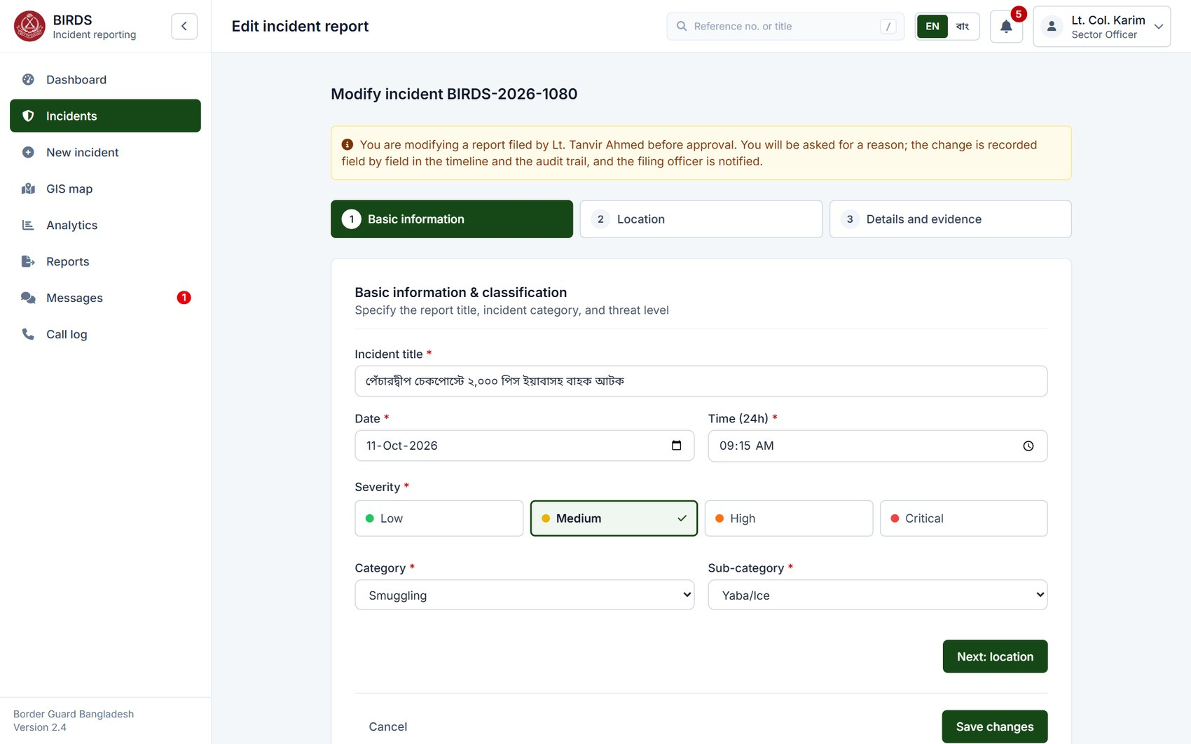
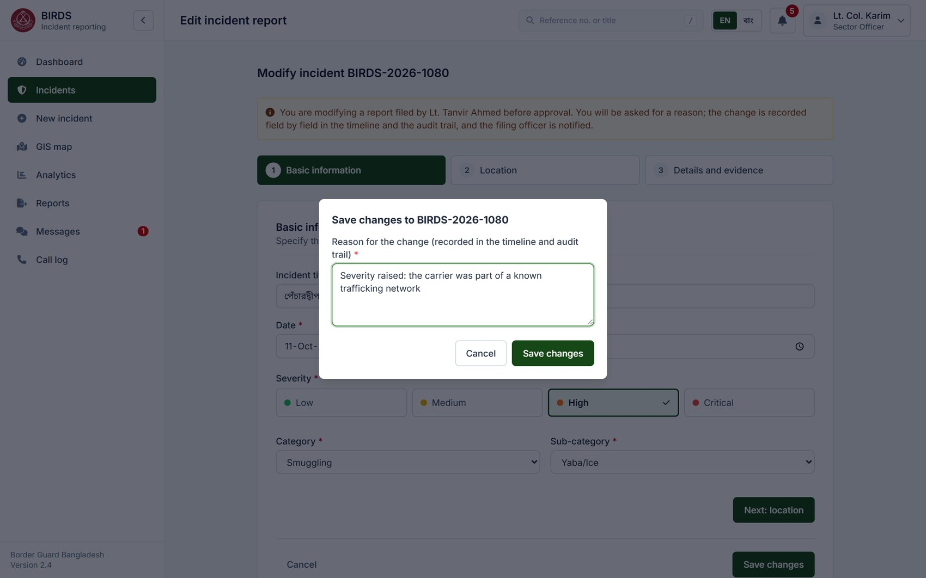
A supervisor modifies the report before approval
Possible while it is submitted, reviewed or verified, for the officer who may act at that stage
"Modify report": the form with a notice
A reason is required to save
#14
Verification & Approval
Review, return, modify, verify, approve, reject
#25
Data Integrity
Never after approval; never one's own report
#13
Workflow Management
Authority-based action at each stage
Notes:
Item 14 asks that supervisory officers can modify a report, not only return it. "Modify report" opens the same form with a notice: the change will be recorded and the filing officer informed. Here Lt. Col. Karim raises the severity from Medium to High.
Saving asks for a reason. Only the officer who may act on the report at its current stage can do this, never on a report they filed, and never once it is approved, closed or rejected; the server enforces all three.
Show: BIRDS-2026-1080 as sector_off / Sector@123 › "Modify report".

Slide 34
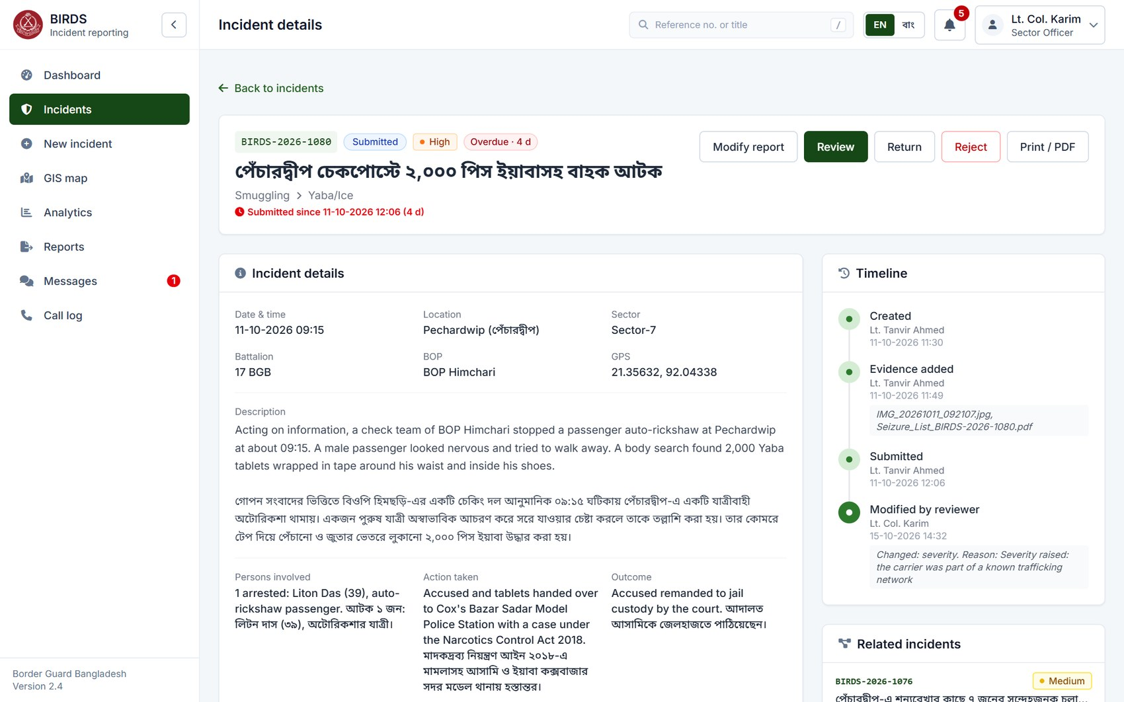
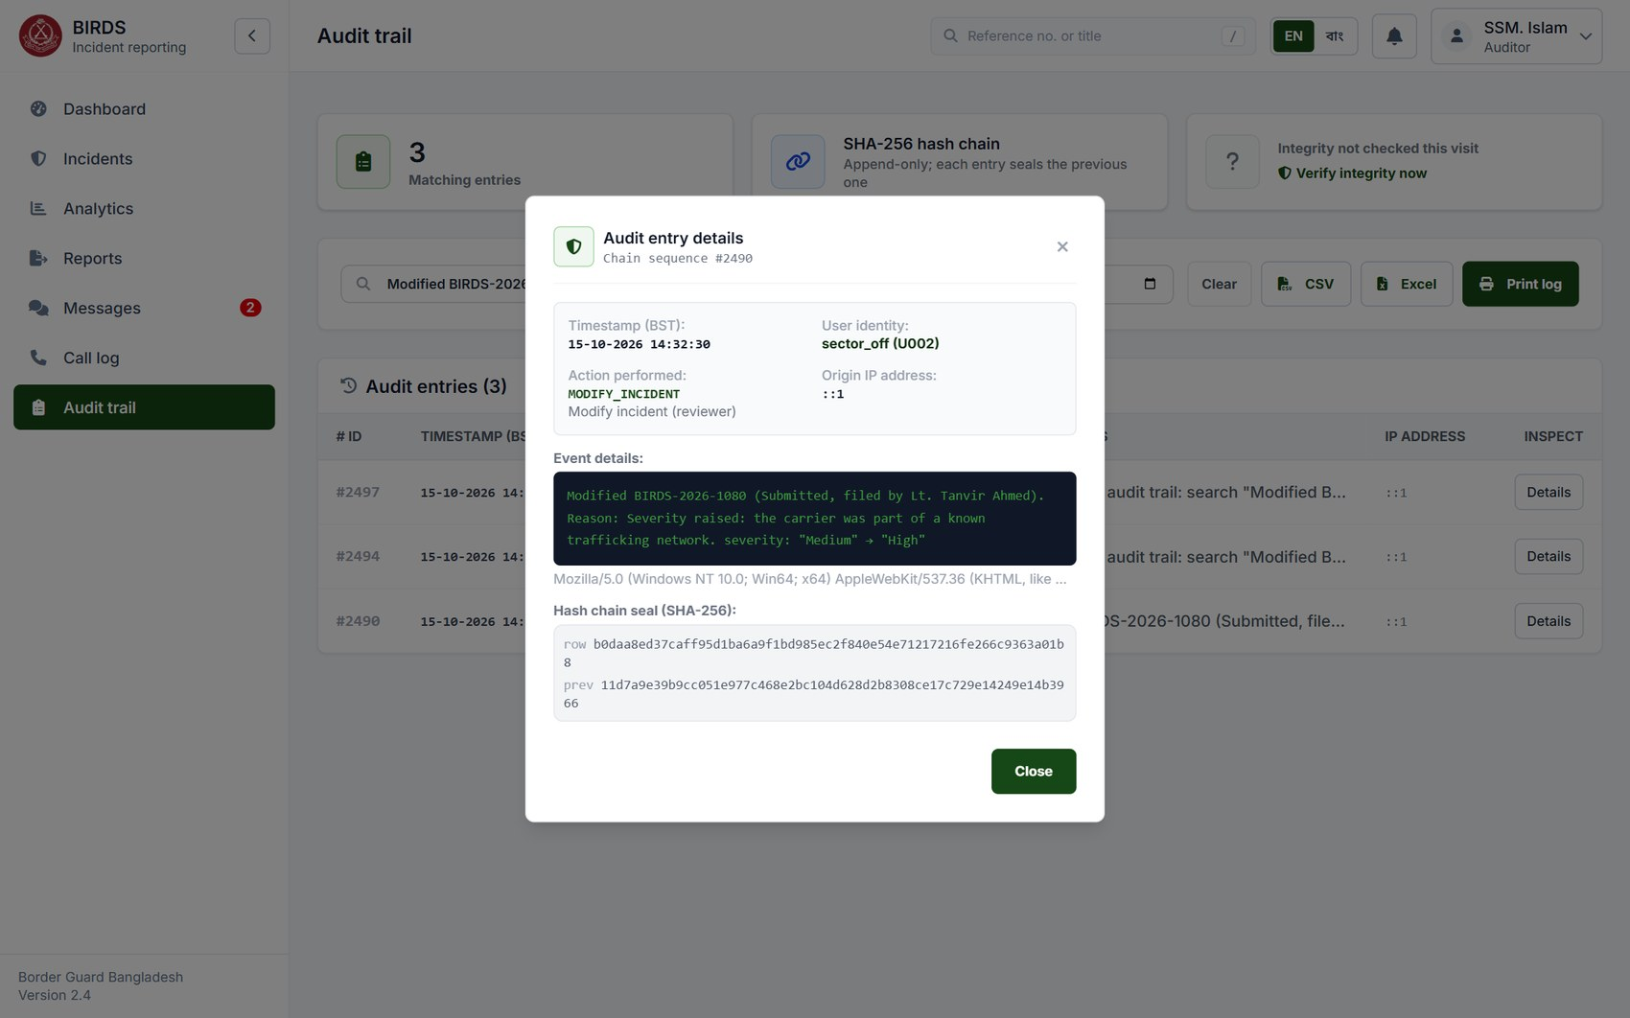
The modification is on record
Timeline entry with the reason; audit entry with each field's old and new value; the filer is notified
"Modified by reviewer" in the timeline
Audit trail: severity "Medium" → "High"
#14
Verification & Approval
Supervisory modification
#12
Incident Timeline
Change and reason in the history
#24
Audit Trail
Tamper-evident audit of the change
Notes:
After saving, the timeline shows "Modified by reviewer" with the changed fields and the reason. The audit trail records each changed field with its old and new value, so anyone can see exactly what the supervisor changed: here severity "Medium" → "High". The filing officer receives a notification.

Slide 35
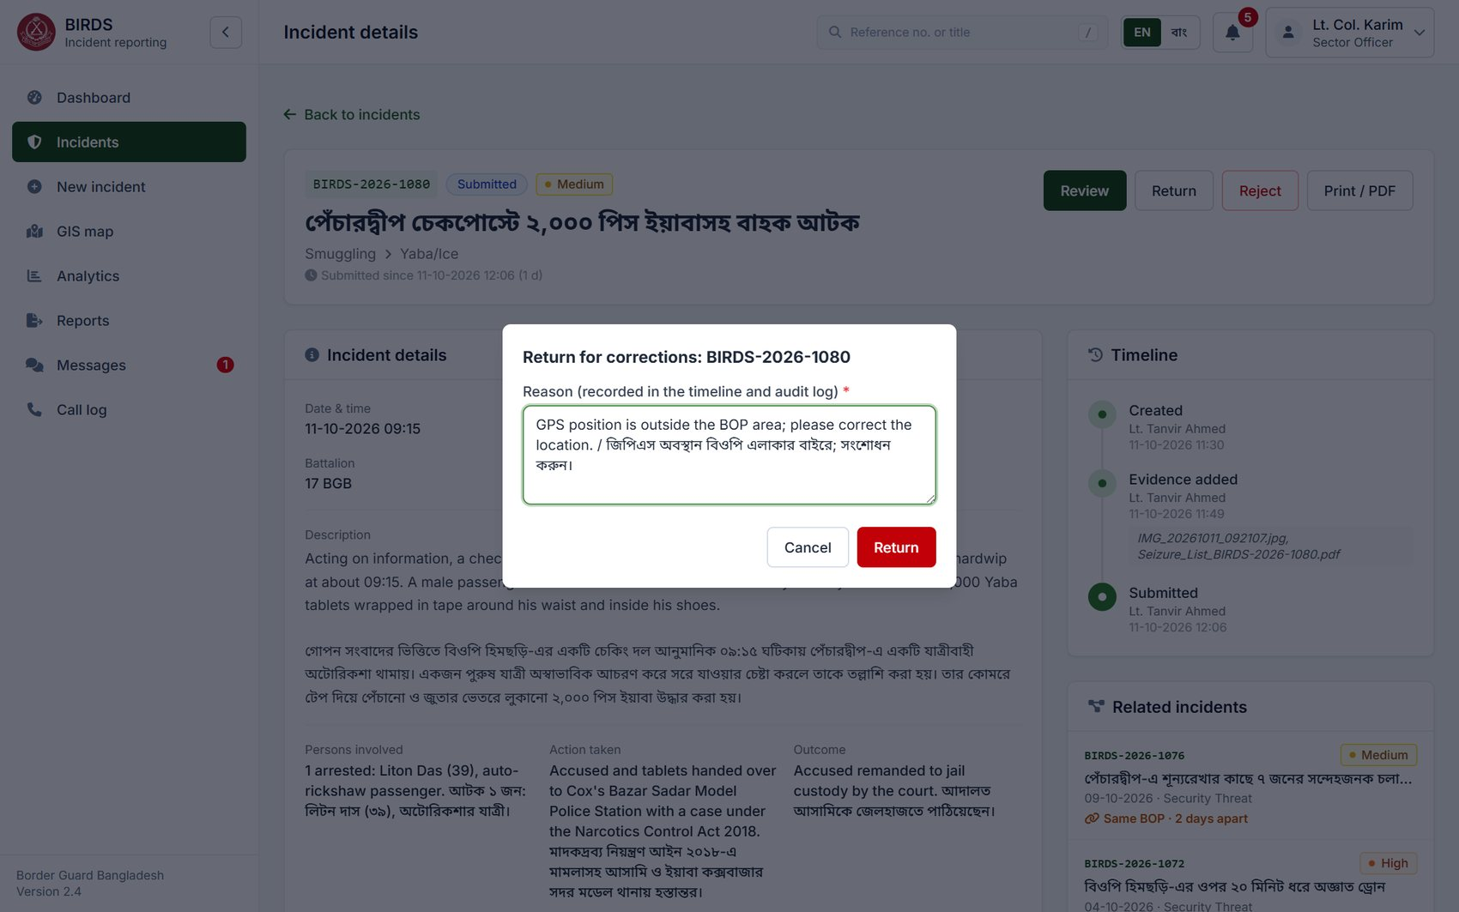
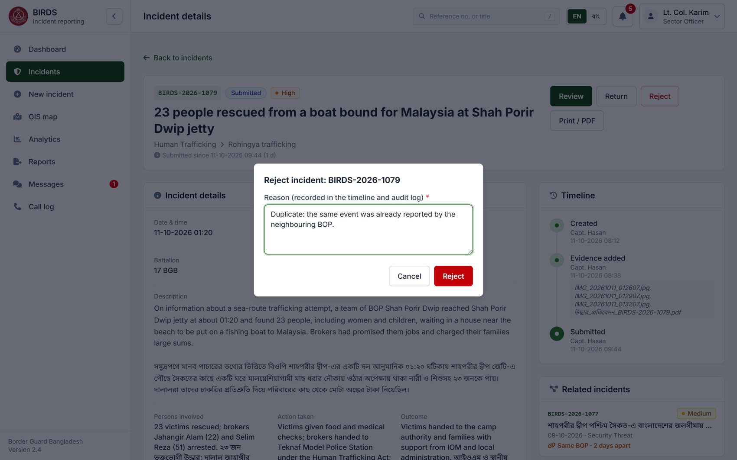
Return for correction, or reject, with a reason
A reason is required; it is kept in the timeline and sent to the filing officer
Return: reason in English and Bangla
Reject: reason required
#14
Verification & Approval
Return and reject by supervisors
#12
Incident Timeline
Reason recorded in the history
#23
Notifications
Filing officer notified
Notes:
Returning a report for correction, or rejecting it, requires a reason. The reason goes into the timeline, the audit trail and the notification to the filing officer.
Show: Return on a submitted report as sector_off; cancel without confirming if you want to keep the demo state.

Slide 36
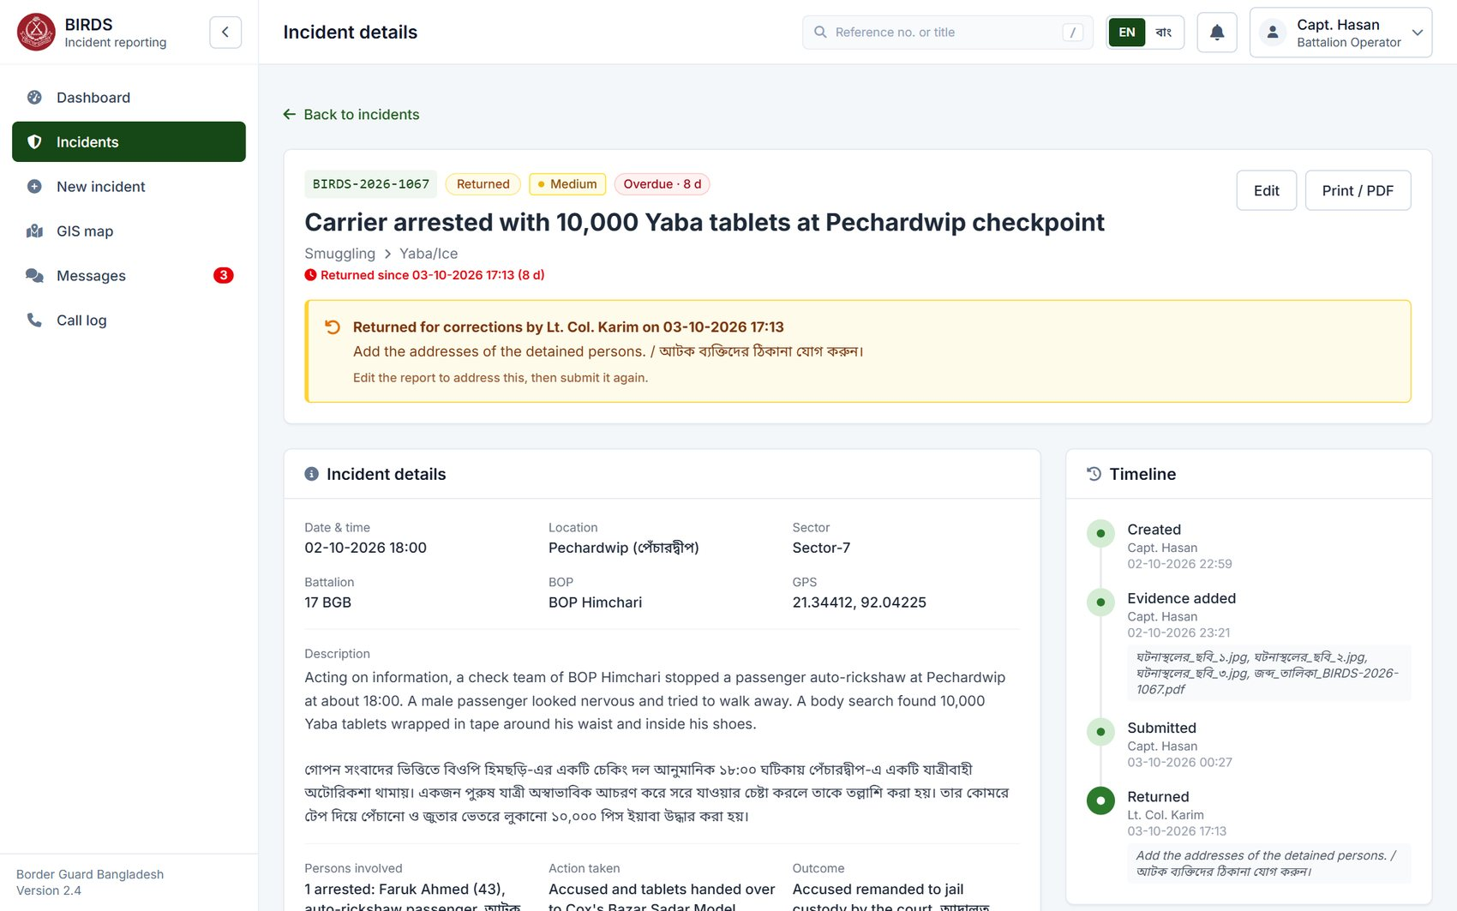
Filing officer corrects and resubmits
A banner states who returned the report, when and why; the filer corrects it and resubmits
Requirements shown
#14
Verification & Approval
Correct after return, then resubmit
#25
Data Integrity
The filer edits only while Draft or Returned
#12
Incident Timeline
Return, edit and resubmission in the timeline
Notes:
Capt. Hasan opens his returned report and sees why: returned by Lt. Col. Karim on 03-10-2026, "Add the addresses of the detained persons". He edits the report and resubmits it.
The officer who filed a report can change it only while it is a draft or returned. After submission, only a supervisor at the current stage can modify it before approval, with a reason and a field-by-field audit entry; once approved, closed or rejected, nobody can.
Show: BIRDS-2026-1067 as batt_op.

Slide 37
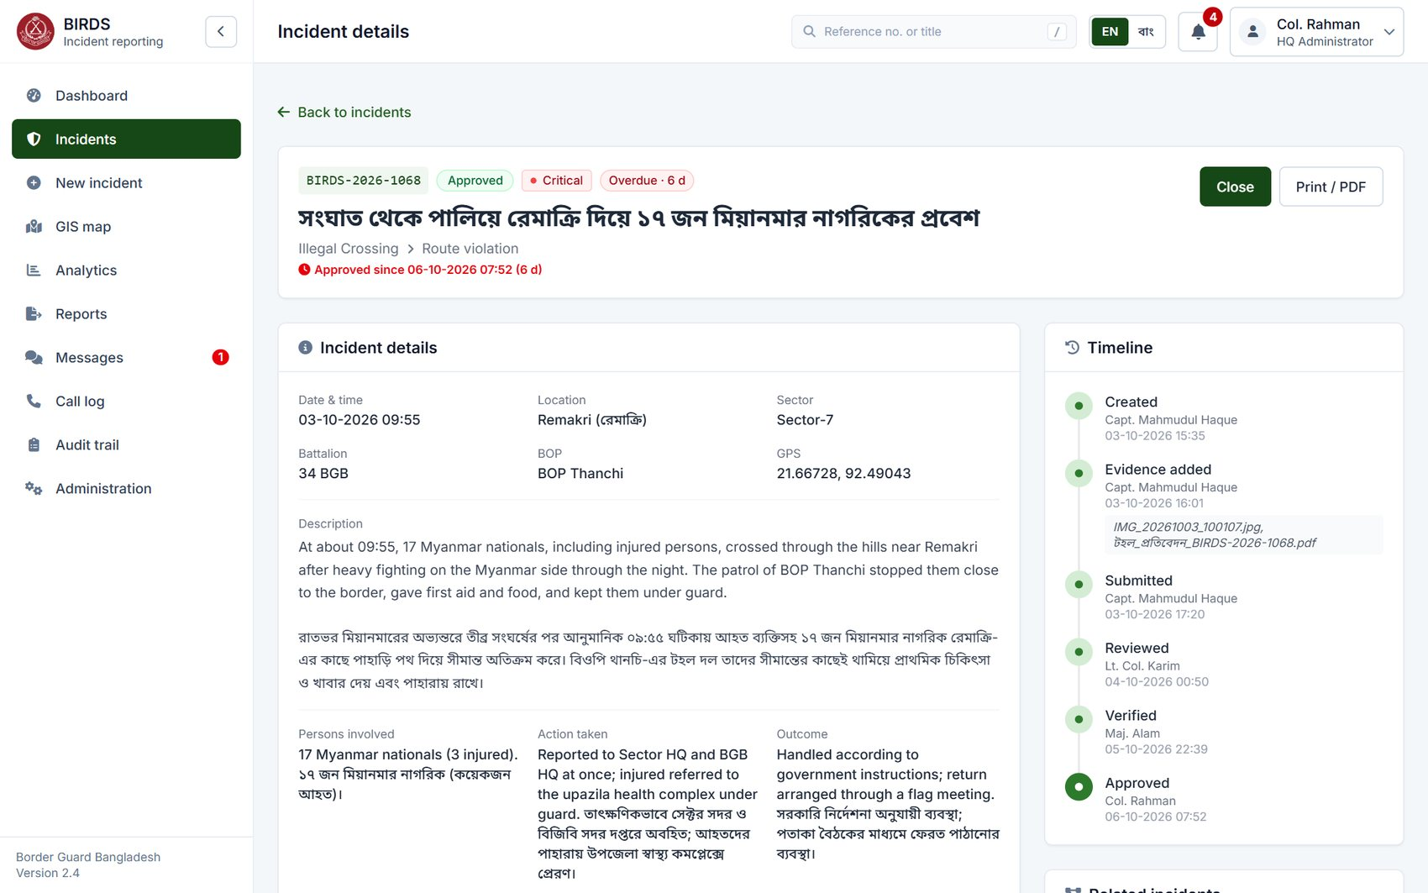
Approval and closure by HQ
Approved reports wait for the HQ administrator to close them
Requirements shown
#13
Workflow Management
Approved → Closed
#14
Verification & Approval
Final approval by the authorised officer
#25
Data Integrity
Closed records cannot be modified
Notes:
After verification, the approver approves, and the HQ administrator closes the case. Closed records can no longer be modified by anyone. This one, BIRDS-2026-1068, waits for Col. Rahman to close it.
Show: hq_admin › Needs my action.

Slide 38
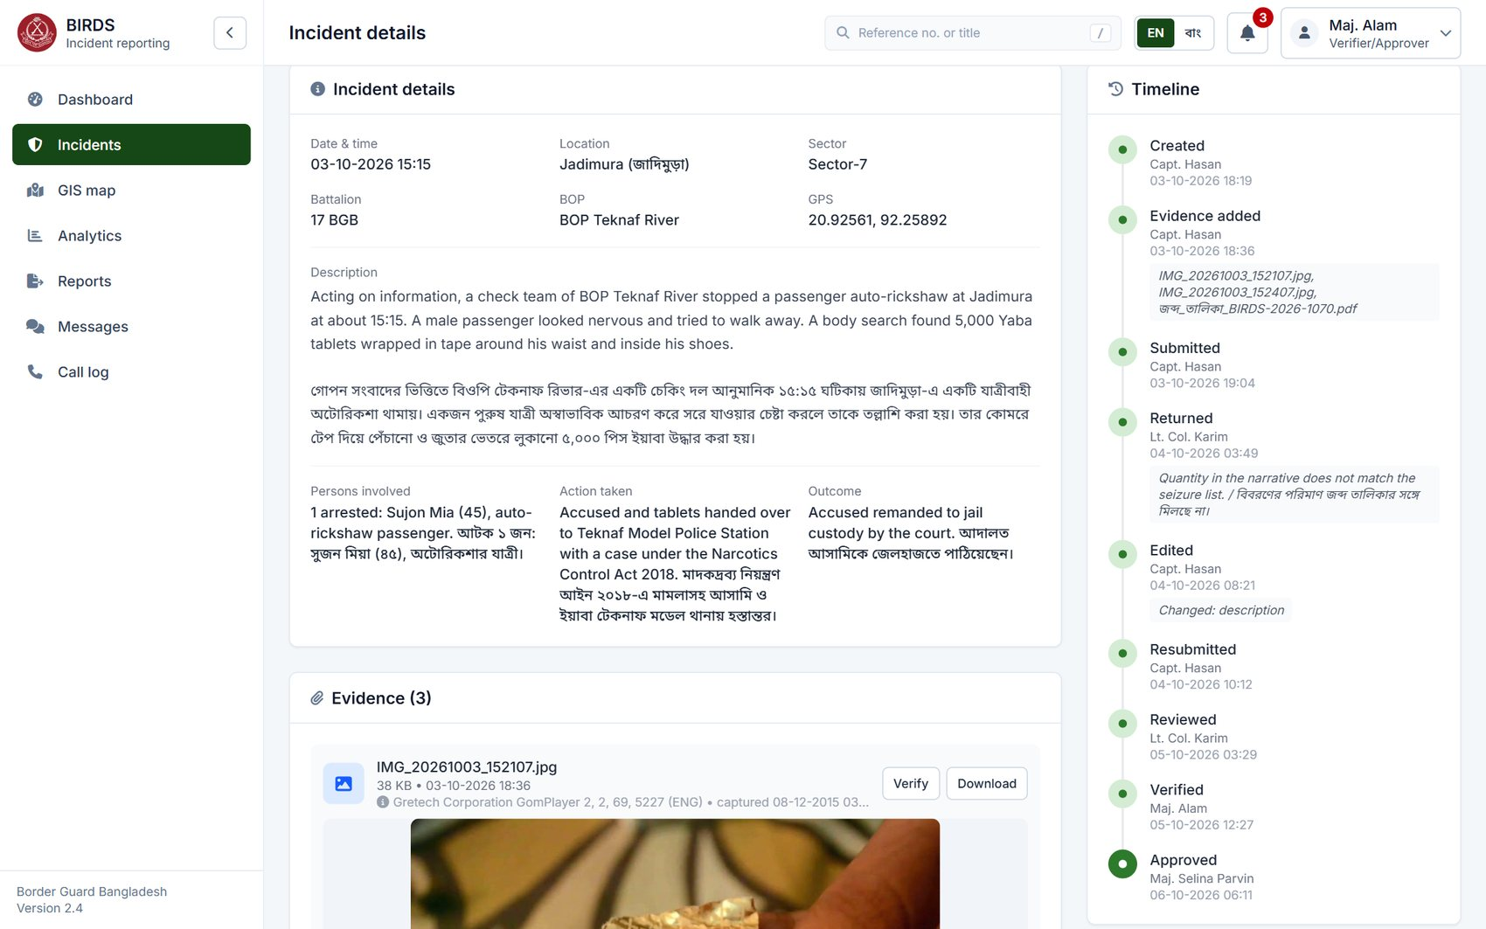
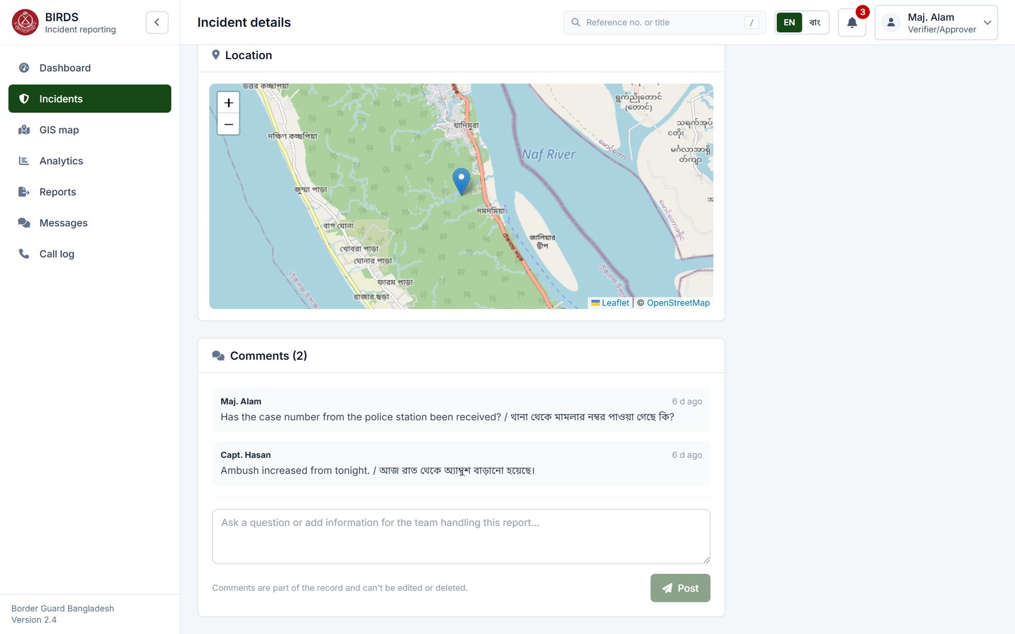
Chronological history and comments
Every step with officer, time and notes; append-only at database level
Timeline: returned, edited, resubmitted, reviewed, verified, approved
Comments from reviewer and filer
#12
Incident Timeline
Reporting, review, verification, approval, closure
#25
Data Integrity
History cannot be edited or deleted
#24
Audit Trail
Each step also in the audit trail
Notes:
The timeline of BIRDS-2026-1070 shows its whole life: filed, returned with a reason, edited, resubmitted, reviewed, verified and approved, each with the officer and the time in Bangladesh time.
Timeline rows and comments are append-only in the database itself: the database refuses to change or delete them, whoever asks.

Slide 39
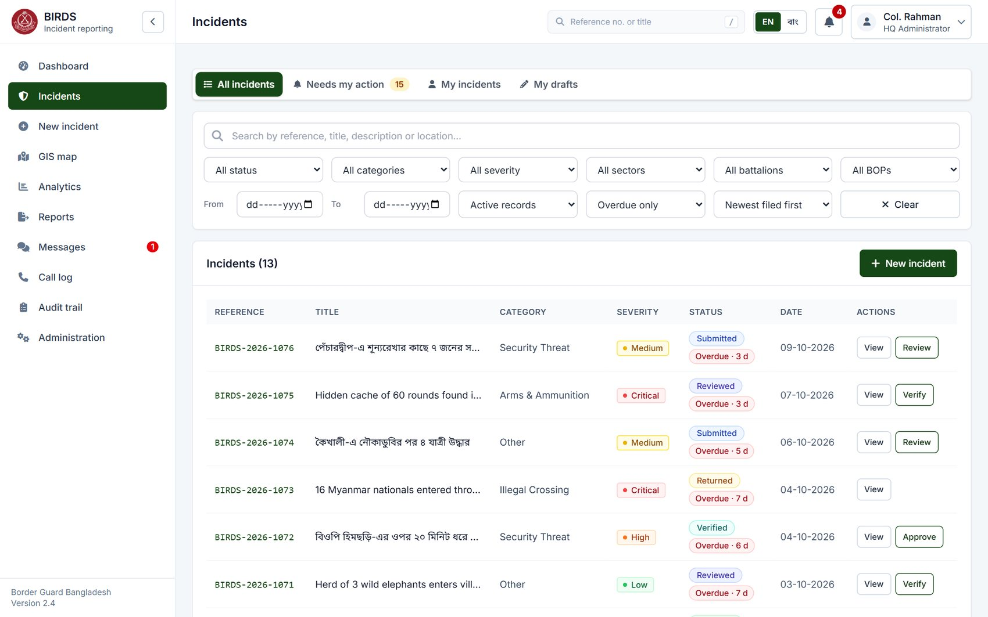
Overdue reports
Reports waiting longer than the configured time in one step, across the officer's area
Requirements shown
#13
Workflow Management
Workflow time monitored
#16
Search Facility
Filter: overdue only
#47
Configuration
Overdue period configurable
Notes:
The "Overdue only" filter lists reports that have waited longer than the configured period in one step, three days in the demo. The badge shows how long. HQ uses this to chase delays; the period is set in Administration.

Slide 40
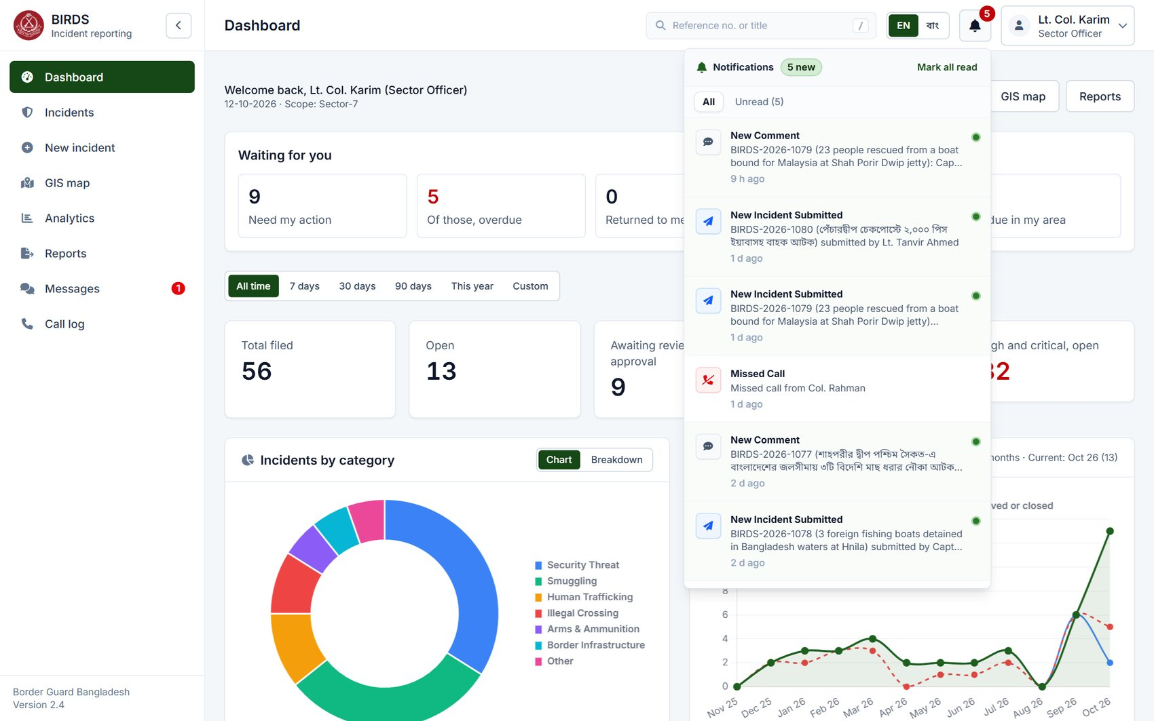
Notifications for workflow events
New submissions, reviews, returns, approvals, comments and missed calls
Requirements shown
#23
Notifications
Alerts for submission, pending verification, approval, return
#14
Verification & Approval
Officers alerted when action is needed
#3
User Management
Only for incidents in the officer's scope
Notes:
The bell shows notifications: here a new comment, new submissions waiting for Lt. Col. Karim and a missed call. Each links to its incident. Notifications go to the next responsible officers within scope, never to the person who acted.
E-mail is sent for submissions, approvals, returns and rejections once an SMTP relay is connected, and push notifications reach phones.

Slide 41
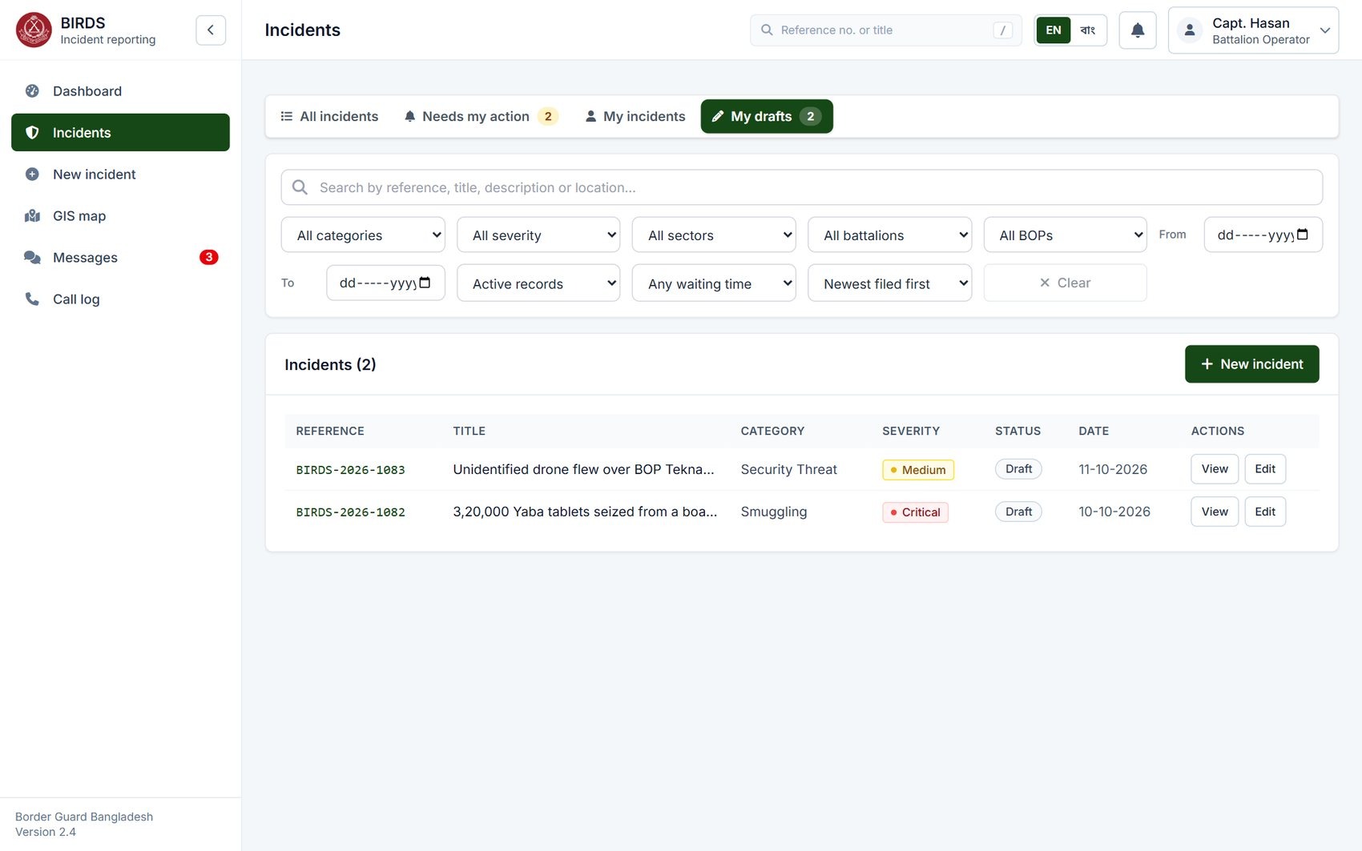
Drafts: saved, not yet filed
Unsubmitted reports are visible only to their author
Requirements shown
#5
Incident Registration
Save as draft and complete later
#25
Data Integrity
Drafts private until submitted
#16
Search Facility
My drafts view
Notes:
Capt. Hasan has two drafts he has not submitted. Drafts are visible only to their author; nobody else sees or counts them until they are submitted. A draft that was never submitted can be discarded; once filed, a report stays on record.

Slide 42
04
Tracking, search and dashboards
Specification items 15–17
Notes:
Section four: tracking, search and the dashboard, items 15 to 17.

Slide 43
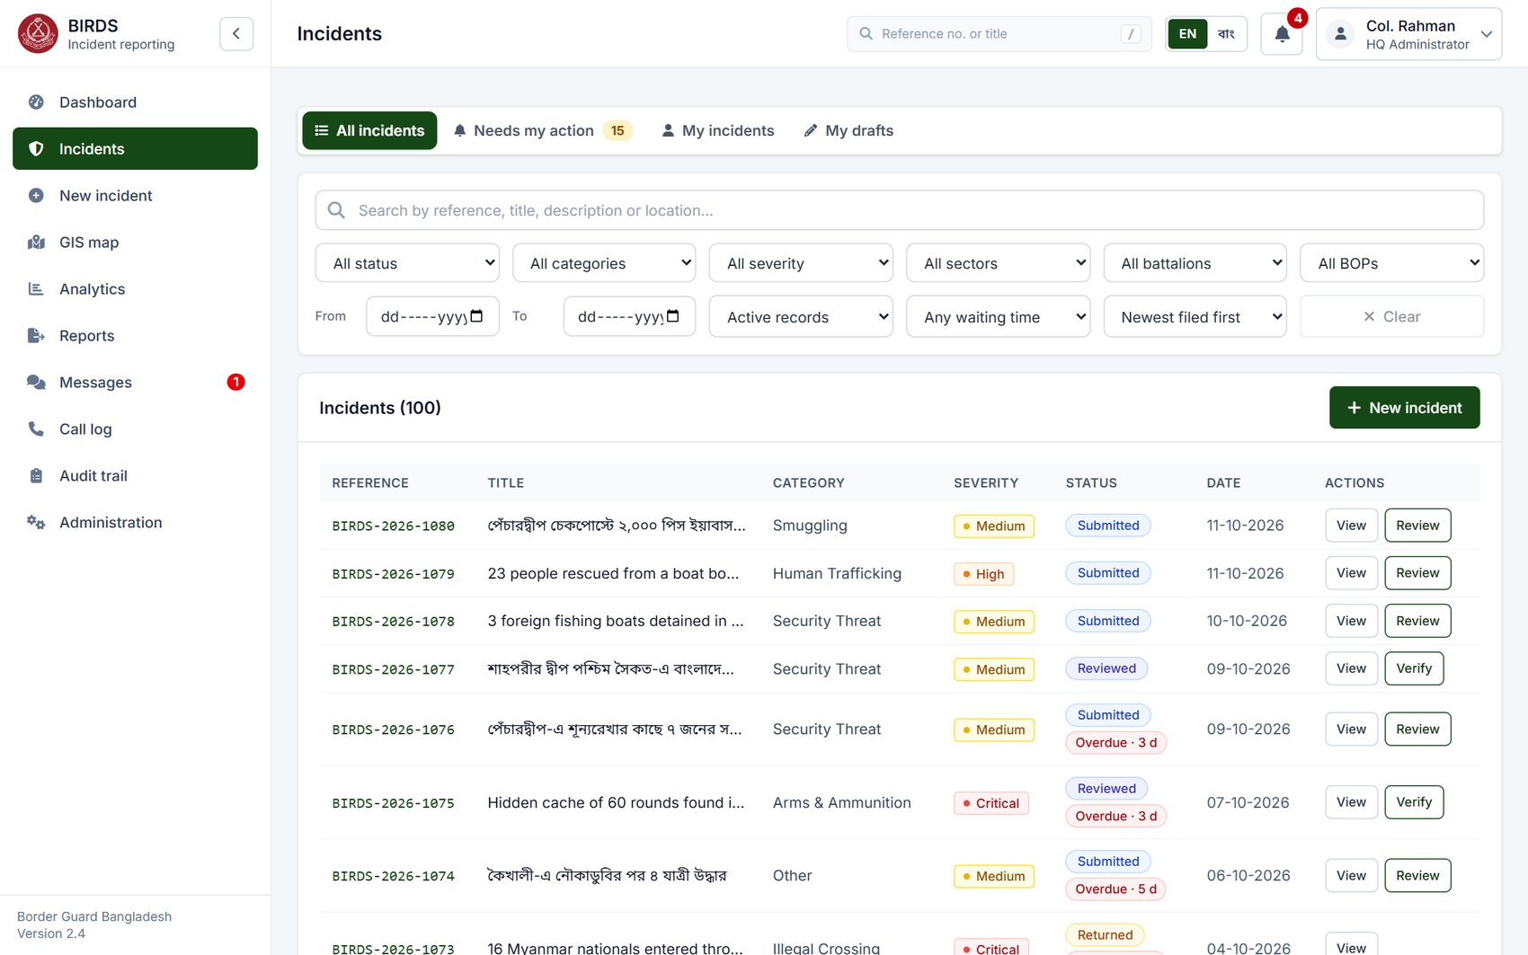
The incident register
Reference, title in English or Bangla, category, severity, status, overdue flag, date, actions
Requirements shown
#15
Incident Tracking
Tracking by reference number and status
#16
Search Facility
Search and filters
#43
Localization
Bangla titles shown as entered
Notes:
The incident register shows every report in the officer's scope, 100 active records for HQ. Titles appear as entered, in Bangla or English. Status, overdue flag and the next action are on each row; columns sort and the list pages.

Slide 44
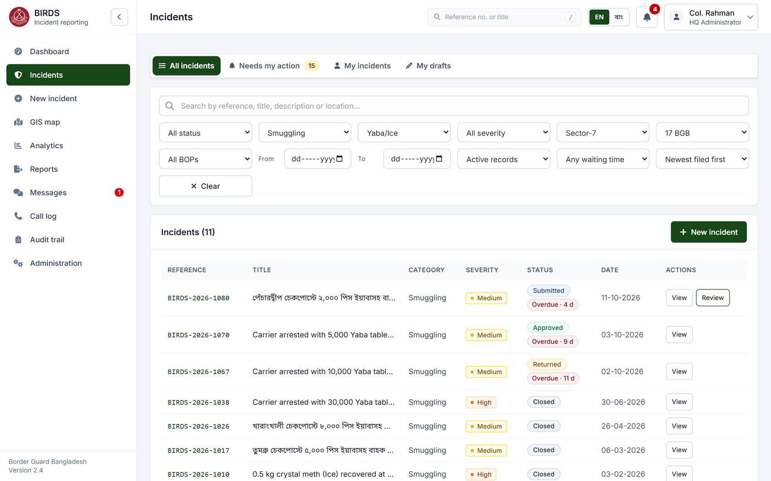
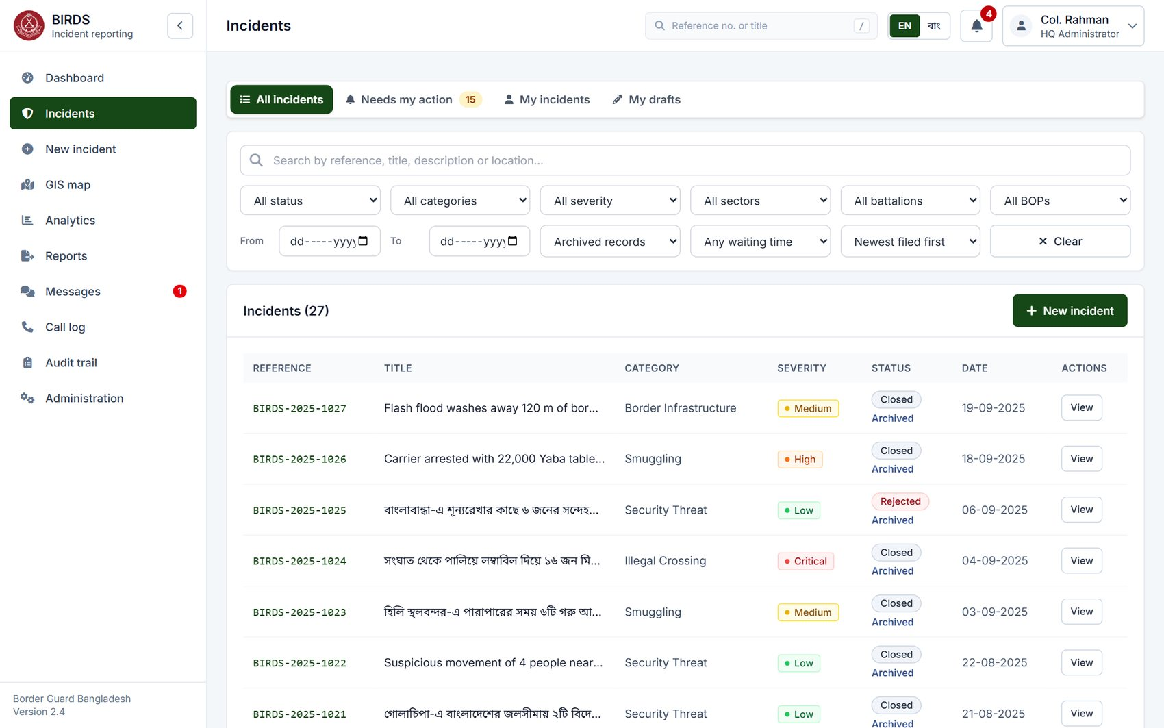
Advanced filters and the archive
By reference, text, status, category, incident type, severity, sector, battalion, BOP, dates, waiting time
Sector-7 · 17 BGB · Smuggling · Yaba/Ice
Archived records only
#16
Search Facility
Advanced search and filtering
#15
Incident Tracking
Track by unit, date and category
#45
Data Archiving
Archived records kept and searchable
Notes:
Filters combine: here Sector-7, 17 BGB, the category Smuggling and the incident type Yaba/Ice. Filters are kept in the address, so a filtered list can be bookmarked or shared.
On the right, the archive: 27 closed records older than a year were archived by the nightly job. They stay searchable, in statistics and on record; nothing is deleted.

Slide 45
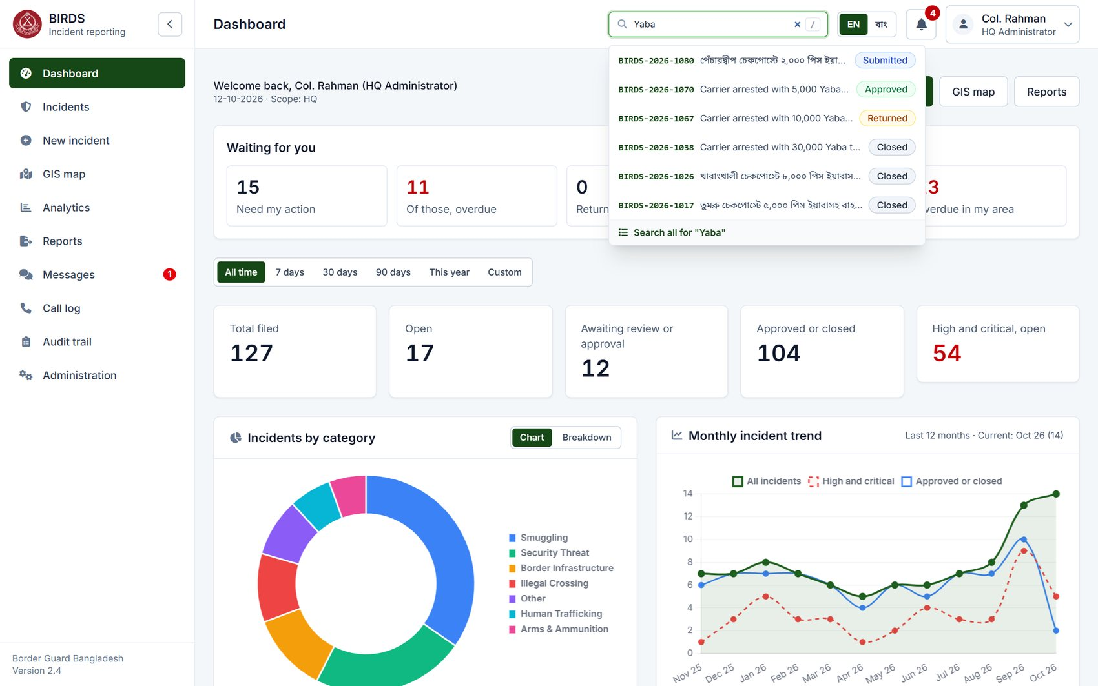
Find any incident from any page
Search by reference number or title from the header; shortcut "/"
Requirements shown
#15
Incident Tracking
Track by reference number
#16
Search Facility
Search facility
#43
Localization
Search in Bangla or English
Notes:
The search box in the header finds incidents by reference number or title from any page; suggestions appear while typing. Here "Yaba" finds recent smuggling reports with their status.

Slide 46
Dashboard: HQ view
"Waiting for you", period selector, totals, open, pending, verified, approved, high and critical; trend
Requirements shown
#17
Dashboard
Role-based dashboard with key indicators
#20
Trend Analysis
Monthly trend
#19
Analytics & Statistics
Incidents by category
Notes:
The HQ dashboard. At the top, "Waiting for you": 15 reports need Col. Rahman's action, 11 of them overdue. Then the period selector and the key figures: 127 filed, 17 open, 12 awaiting review or approval, 106 verified (passed verification, including approved and closed), 104 approved or closed, 54 high or critical.
Below, incidents by category and the 12-month trend with high and critical incidents and approvals.
Show: Dashboard as hq_admin; change the period to 90 days.

Slide 47
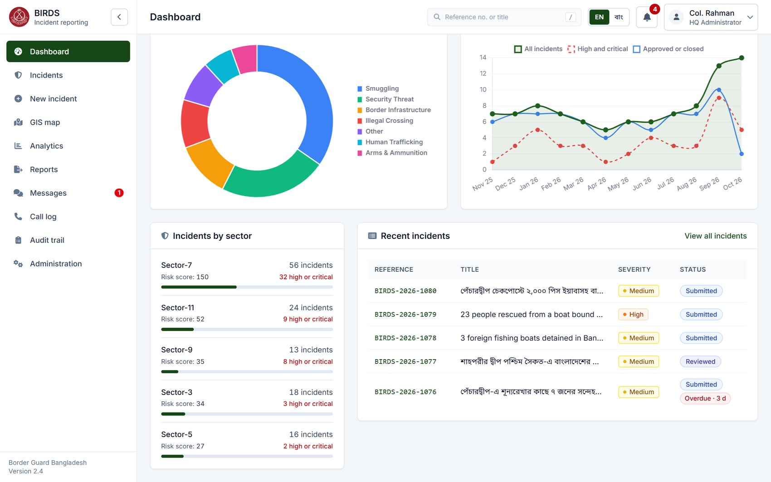

Dashboard: sectors, recent reports and category detail
Every figure opens the matching list of incidents
Incidents by sector and recent reports
Category breakdown with high/critical share
#17
Dashboard
Operational indicators
#19
Analytics & Statistics
By category, sector and severity
#16
Search Facility
Click-through to the incident list
Notes:
Further down: incidents by sector with a severity-weighted risk score, and the most recent reports. The category card can switch from chart to breakdown, showing the high and critical share of each category. Clicking any figure opens those incidents.

Slide 48

An archived record
Read-only and hidden from active lists; the administrator can restore it with a reason
Requirements shown
#45
Data Archiving
Archiving with audit trail
#44
Data Retention
Retention policy applied
#25
Data Integrity
Archived records cannot be changed
Notes:
An archived incident from April 2026 opens read-only with a banner stating when it was archived. The administrator can restore it with a reason; both archiving and restoring are in the timeline and the audit trail.

Slide 49
05
GIS map dashboard
Specification items 8, 18
Notes:
Section five: the GIS map, items 8 and 18. Where incidents happen, how to zoom in on a place and go from the map to the incidents and back.

Slide 50

Incidents along the whole border
One point per BOP with its number of incidents, coloured by the most severe; the map frames the incidents shown
Requirements shown
#18
GIS/Map Dashboard
Map dashboard with markers by severity
#8
Geographical Information
Incidents identified geographically
#9
Border Sector Information
Grouped by BOP of the hierarchy
Notes:
The map shows the 127 geotagged incidents from Tetulia in the north to Teknaf in the south. Each point is a BOP; the number is its incidents, the size grows with it, and the colour is the most severe incident there. Where points overlap, the busiest stays on top.
On opening, the map flies in from the whole country to the area of the incidents shown, and again whenever a filter changes the set.
Show: GIS map as hq_admin.

Slide 51

Hover: the latest incidents at a place
Pointing at a BOP shows its total and its two most recent incidents
Requirements shown
#18
GIS/Map Dashboard
Map with incident details on demand
#15
Incident Tracking
Reference numbers shown
#8
Geographical Information
Location identified
Notes:
Pointing at a point shows the BOP, its total, and its two most recent incidents with reference number and date, here BOP Ghumdhum with 8 incidents.

Slide 52

Click: zoom in on the place
The map zooms to street level; the popup lists the latest incidents with links; zoom and close buttons appear
Requirements shown
#18
GIS/Map Dashboard
Interactive map: zoom to a location
#8
Geographical Information
Geographic position in detail
#16
Search Facility
"Show all" opens that place's incidents
Notes:
Clicking the point zooms the map in on it, street level, and opens the popup with the last two incidents and "View details" for each.
Zoom in, zoom out and the close button appear at the top right while zoomed in. The close button returns to the whole country.

Slide 53



From the map to the incidents, and back
Zoom further, open every incident of the place, return to the map exactly as it was
1 · Zoom in further with +
2 · "Show all 8 incidents" opens the register
3 · "Back to the map": same view, same popup
#18
GIS/Map Dashboard
Map linked to the incident register
#16
Search Facility
Filtered list of a location
#15
Incident Tracking
Tracking by location
Notes:
Step one: zoom in further with the plus button. Step two: "Show all 8 incidents" opens the incident register filtered to BOP Ghumdhum, with the map's filters carried over. Step three: "Back to the map" returns to the map exactly as it was left: same filters, same zoom, same popup open. The browser's Back button does the same.
Show: click a point, Show all, then Back to the map.

Slide 54


Back to the whole country, or filter
The close button returns to Bangladesh; filters by category, severity, status and dates move the map to the matching incidents
Close: whole country again
Severity: Critical only
#18
GIS/Map Dashboard
Filters by category, severity, status, date
#19
Analytics & Statistics
Spatial pattern of severe incidents
#8
Geographical Information
Geographic analysis
Notes:
The close button returns to the whole country. Filters re-draw the map and fit it to the matching incidents: Critical only, 17 incidents, mostly along the Myanmar border.

Slide 55


Clusters
Every incident as its own marker, grouped by zoom level; clicking a group zooms into it
Clusters coloured by the most severe incident
Clicking a cluster zooms in to its incidents
#18
GIS/Map Dashboard
Configurable map display
#8
Geographical Information
Individual incident positions
#19
Analytics & Statistics
Concentration of incidents
Notes:
Clusters mode shows each incident at its own GPS position, grouped by zoom level, each group coloured by its most severe incident. Clicking a group zooms into it until the individual incidents separate.

Slide 56

Heat map
Concentrations of incidents, weighted by severity
Requirements shown
#18
GIS/Map Dashboard
Map display: points, clusters, heat map
#19
Analytics & Statistics
Frequency and severity by area
#20
Trend Analysis
Combined with date filters for periods
Notes:
The heat map weights each incident by severity, so concentrations of serious incidents stand out: Teknaf and the Naf River, the south-west around Benapole and Satkhira, and the north around Burimari and Hili.

Slide 57


Incident locations and the map on a phone
Below the map, every location with its status; on a phone the controls move below the popup
Requirements shown
#18
GIS/Map Dashboard
Map with incident list
#41
Mobile Responsiveness
Usable on phones
#8
Geographical Information
Positions with coordinates
Incident locations list under the map
Phone: popup and zoom controls
Notes:
Under the map, every incident location with coordinates and status, each opening the incident. On a phone the map works the same way; the zoom controls move to the bottom so they never cover the popup.

Slide 58
06
Analytics and trends
Specification items 19, 20
Notes:
Section six: analytics and trend analysis, items 19 and 20. Every chart opens the incidents behind it.

Slide 59

Key figures and the trend
Period, sector and battalion selectors; trend of all, high/critical and the previous year
Requirements shown
#20
Trend Analysis
Trend by day, week, month, quarter, year
#19
Analytics & Statistics
Statistics for the selected period
#17
Dashboard
Key indicators
Notes:
Analytics for the last year: 94 incidents, 8 % more than the previous month, 42 high or critical, a resolution rate of 79 %, and 12 pending review, 13 of them overdue, with a link to those.
The trend shows all incidents, the high and critical ones, and the same months a year earlier as a dashed line. Clicking a point opens that month's incidents.
Show: Analytics as hq_admin.

Slide 60

By severity, category and sector
Bars split into high/critical and other incidents; clicking a bar opens those incidents
Requirements shown
#19
Analytics & Statistics
By type, location, unit, severity
#16
Search Facility
Drill-down to the incident list
#17
Dashboard
Operational indicators
Notes:
Severity, category and sector breakdowns. Categories are sorted bars split into high or critical and the rest, so the most serious problems stand out: smuggling and security threats. The sector chart stacks the four severity levels.
Any bar opens the matching incidents with the same period.

Slide 61

When incidents happen, and where
Busiest hours, night share, weekday pattern; the riskiest BOPs by severity-weighted score
Requirements shown
#19
Analytics & Statistics
Frequency by time and location
#18
GIS/Map Dashboard
Hotspot BOPs
#20
Trend Analysis
Patterns over time
Notes:
"When incidents happen": the busiest hour is 02:00 to 03:00, and 62 % of incidents happen at night, between 18:00 and 06:00, which supports night ambush planning. Below, the pattern by day of the week.
Hotspots: the BOPs with the highest severity-weighted risk score, with their high or critical count and latest date. Each opens its incidents.

Slide 62

Sector risk summary
Totals, high/critical ratio, risk score and assessment for each sector, with how they are calculated
Requirements shown
#19
Analytics & Statistics
Risk by sector
#17
Dashboard
Management indicators
#21
Reporting
Basis for the sector report
Notes:
The sector risk summary: for each sector, total incidents, the share that is high or critical, the risk score and an assessment. The rule is printed under the table: 60 % or more is a critical sector, 40 % high risk, 20 % moderate; the score weights Low 1 to Critical 4.

Slide 63

Every chart opens its incidents
A click on "Smuggling" opened these 29 incidents with the same period
Requirements shown
#16
Search Facility
From statistics to the records
#19
Analytics & Statistics
Analysis linked to data
#15
Incident Tracking
Tracking by category and date
Notes:
Clicking the Smuggling bar opened the register with the analytics period and the category set: 29 incidents. The figures and the records always agree, because both come from the same server query.

Slide 64



Any period, any granularity, any unit
Daily for 30 days, quarterly over 3 years, or one sector
Last 30 days, daily
3 years, quarterly
Sector-7 only
#20
Trend Analysis
Day, week, month, quarter, year
#19
Analytics & Statistics
By sector and battalion
#3
User Management
Figures limited to the officer's scope
Notes:
The same page for 30 days by day, three years by quarter, and Sector-7 only. A battalion operator sees only his battalion's figures; the server applies the scope to every number.

Slide 65
07
Reports, printing and export
Specification items 21, 22
Notes:
Section seven: reports, printing and export, items 21 and 22. Four report templates, a formal printed document, the full incident annex, the single-incident printout, and Excel and CSV.

Slide 66

Configurable reports
Template, period, unit, category, severity and status; summary figures on screen
Requirements shown
#21
Reporting
Operational, statistical and management reports
#16
Search Facility
Same filters as the register
#22
Export
Print / PDF, Excel, CSV
Notes:
The Reports page: choose a template, the period, the unit, category, severity and status, then "Update report". Here the operational log for 1 September to today: 27 incidents, 14 high or critical, 13 overdue.
Option "Include full details of each incident" adds the annex with every incident and its evidence.
Show: Reports as hq_admin.

Slide 67

Report overview on screen
Distribution by category and sector, and the register of incidents in the report
Requirements shown
#21
Reporting
Report content reviewed before printing
#19
Analytics & Statistics
Statistical tables
#15
Incident Tracking
Incidents listed by reference
Notes:
On screen the report shows its tables: distribution by category with high or critical share, distribution by sector with risk score, and the register of every incident in the report. Nothing is printed until the officer chooses Print / PDF.

Slide 68

Print preview: the formal document
Exactly as it will print: crest, letterhead, classification, reference, subject, numbered sections
Requirements shown
#21
Reporting
Printable formal report
#22
Export
Print and PDF
#24
Audit Trail
Each print gets a reference and an audit entry
Notes:
Print / PDF opens a preview of the formal document exactly as it prints: CONFIDENTIAL // OPERATIONAL, the crest and letterhead, the reference "issued when printed", the date and subject, then numbered sections.
When the officer prints, the server issues the next reference number and records the print in the audit trail.

Slide 69


The printed report (PDF)
Page 1 and 2 of the operational report as printed: reference BGB/BIRDS/RPT/2026/0001
Requirements shown
#21
Reporting
Formal operational report
#22
Export
PDF export
#26
Data Security
Classification marking on every page
Page 1: scope and parameters
Page 2: summary and distributions
Notes:
These are the real printed pages, saved as PDF from the browser. Page one: the reference number BGB/BIRDS/RPT/2026/0001, scope and parameters. Page two: the summary of incidents and the distributions. The classification marking is at the top and bottom of every page with "Page x of y".

Slide 70


Register, certificate and signatures
The printed register of incidents; certificate, prepared / checked / approved blocks and distribution
Requirements shown
#21
Reporting
Management report with sign-off
#24
Audit Trail
Printed by, at, under reference
#22
Export
Printable document
Register of incidents
Signature blocks and distribution
Notes:
The last pages: the register of incidents in the report, a certificate that the figures come from the BIRDS records at the stated time, the Prepared, Checked and Approved signature blocks, prefilled with the officer who printed it, and the distribution list.

Slide 71



Four report templates
Statistical & threat summary, high-threat alert digest, sector performance report
Statistical & threat summary
High-threat alert digest
Sector performance report
#21
Reporting
Operational, statistical, management reports
#19
Analytics & Statistics
Statistics by sector and threat
#22
Export
Each printed as PDF
Notes:
Besides the operational log there are three more templates: the statistical and threat summary, the high-threat alert digest of high and critical incidents only, and the sector performance report. Each prints in the same formal layout with its own reference number.

Slide 72

Report with full incident details
"Include full details of each incident": every incident on its own page, with its evidence
Requirements shown
#21
Reporting
Reports with full incident detail
#10
Evidence & Document Management
Evidence reproduced
#7
Incident Details
All captured details
Notes:
Ticking "Include full details of each incident" adds Annex A: each incident in the report on its own page, with all its particulars, timeline and evidence; photographs are reproduced and each video gets a still frame. Here for the high-threat digest: 14 incidents.

Slide 73


Annex: each incident with its evidence
Real printed pages of the annex: particulars, narrative, persons, action, outcome and evidence with metadata
Requirements shown
#21
Reporting
Full detail of each incident in the report
#10
Evidence & Document Management
Photographs reproduced, video still frames
#11
Media Metadata
Metadata and SHA-256 printed
Annex A-1: particulars and narrative
Evidence: photos with camera, size, SHA-256
Notes:
Two printed annex pages for BIRDS-2026-1079, the rescue at Shah Porir Dwip. First the particulars and the bilingual narrative; then the evidence: each photograph reproduced with its file name, type, size, camera, capture and upload time and SHA-256 fingerprint. A document that cannot be reproduced is listed with its details. The full report with annex was 42 pages.

Slide 74

Printing one incident
Print / PDF on the incident page: the full record in the same formal layout
Requirements shown
#22
Export
PDF of one incident
#12
Incident Timeline
Record history included
#24
Audit Trail
Print recorded with its reference
Notes:
Each incident can be printed on its own from its page: the same formal layout with the incident's particulars, narrative, evidence, record history and signature blocks. It gets its own reference number and audit entry.
Show: BIRDS-2026-1072 › Print / PDF.

Slide 75


The single-incident printout (PDF)
Particulars, narrative and evidence of BIRDS-2026-1072, as printed
Requirements shown
#22
Export
Printable incident record
#10
Evidence & Document Management
Evidence with captions
#43
Localization
Bangla text in the printout
Page 1: particulars and narrative
Page 2: action, outcome, evidence
Notes:
The printed incident record: particulars, the Bangla title and the bilingual narrative, action and outcome, and the evidence with photographs and their metadata, followed by the record history and signatures.

Slide 76

Excel and CSV export
The real export file: classification, title and generation line, then one row per incident
Requirements shown
#22
Export
Excel and CSV export
#24
Audit Trail
Every export audited
#43
Localization
Bangla text kept in the file
Notes:
Excel and CSV are generated by the server. The file starts with CONFIDENTIAL // OPERATIONAL, the report title and who generated it, when and with which filters, then one row per incident. Bangla text is kept. Every export is recorded in the audit trail, and cells are protected against formula injection.

Slide 77
08
Audit trail and data integrity
Specification items 24, 25
Notes:
Section eight: the audit trail and data integrity, items 24 and 25.

Slide 78

Tamper-evident audit trail
Every significant action: sign-ins, workflow, evidence views, prints, exports, settings, calls
Requirements shown
#24
Audit Trail
Comprehensive audit logging
#48
Logging & Monitoring
User, time, action, details, IP address
#22
Export
Export to CSV or Excel; print
Notes:
The audit trail of the demo holds about 2,500 entries since installation in March 2025: sign-ins and sign-outs, every workflow action, evidence uploads and views, prints with their reference numbers, exports, settings changes, user management and calls. Each has user, time, action, details and IP address. It can be searched, filtered, exported and printed.
Show: Audit trail as auditor / Audit@123.

Slide 79

One click verifies the whole chain
Each entry is sealed with the hash of the previous one; "Chain intact" covers all entries
Requirements shown
#24
Audit Trail
Tamper-evident logging
#25
Data Integrity
Alteration or deletion detected
#26
Data Security
Protected at database level
Notes:
Each entry stores a SHA-256 hash of its contents and of the entry before it, so the entries form a chain. "Verify integrity now" recomputes the chain in the database and reports "Chain intact" with the number of entries checked. If any entry had been changed or removed, it would report the first broken entry. Updates and deletions of audit rows are refused by the database itself.

Slide 80

Entry details and its seal
Who, when, from where, what, and the hash linking it to the previous entry
Requirements shown
#24
Audit Trail
Detail of each audit event
#25
Data Integrity
Hash chain per entry
#48
Logging & Monitoring
Browser and IP recorded
Notes:
Details of one entry: time in Bangladesh time, user identity, action, origin IP address, browser, the full event details, and the two hashes: the previous entry's and this one's.

Slide 81


Filter by action, or follow one incident
Every print with its reference; everything that happened to BIRDS-2026-1072
Action: Print report
Search: BIRDS-2026-1072
#24
Audit Trail
Audit search and filter
#22
Export
Printouts traceable by reference
#12
Incident Timeline
Complete trace of one record
Notes:
Filtering by action shows, for example, every printed report with its reference number, so any paper copy can be traced. Searching for an incident number shows everything that happened to it: who viewed, verified, printed or downloaded its evidence, and when.

Slide 82
09
Administration and configuration
Specification items 3, 6, 9, 13, 44–47, 55
Notes:
Section nine: administration and configuration, everything that can be changed without code changes.

Slide 83

Users and roles
21 accounts: role, unit scope, status and last sign-in; create, edit, reset, deactivate
Requirements shown
#46
Administrative Module
Central administration of users
#3
User Management
Role and scope per user
#29
Password Security
Password reset, unlock
Notes:
User accounts: 21 in the demo, each with role, unit scope, status and last sign-in. The administrator creates users, edits role and scope, resets passwords with a one-time temporary password, unlocks and deactivates; accounts are never deleted, so the history stays complete. One former 8 BGB operator is deactivated.

Slide 84

Editing an account
Name, username, e-mail, role and unit; a change of role or scope ends the user's sessions
Requirements shown
#3
User Management
Configurable roles and scopes
#46
Administrative Module
User management
#28
Session Security
Sessions ended on privilege change
Notes:
Editing an account: name, username, e-mail, role and scope. When role or scope changes, the user's current sessions end at once so nothing runs on the old privileges. The administrator cannot demote themself, and the last HQ administrator cannot be removed.

Slide 85

Permissions matrix
Which role may open which module; changes apply on the next request; reset to defaults
Requirements shown
#3
User Management
Configurable roles and privileges
#47
Configuration
Without code changes
#24
Audit Trail
Every change audited
Notes:
The permissions matrix: each role's access to each module, as checkboxes. The server enforces the matrix on every request. Administration access for the HQ administrator is locked so nobody can lock themselves out.

Slide 86

Incident categories
Categories and sub-categories with their use; add, rename unused, deactivate
Requirements shown
#6
Incident Classification
Configurable classification
#55
Customization
Customisation of forms
#47
Configuration
No code changes
Notes:
Incident categories and sub-categories, with the number of incidents in each. New ones can be added at any time; categories already used keep their name so history stays consistent, and can be deactivated instead.

Slide 87

Organisational hierarchy
HQ → 5 sectors → 10 battalions → 32 BOPs; units added by the administrator
Requirements shown
#9
Border Sector Information
Configurable organisational hierarchy
#55
Customization
Customisation of the hierarchy
#3
User Management
Scopes follow the hierarchy
Notes:
The hierarchy of the demo: HQ, five sectors, ten battalions and 32 BOPs, each placed at its real location. New units are added here. Units are never renamed or removed once used, because incidents and user scopes refer to them.

Slide 88


Archiving, retention and e-mail
Archive after 365 days; retention 3,650 days; nightly archiving; e-mail outbox
Archiving and retention with counts
E-mail notifications and delivery status
#44
Data Retention
Configurable data retention
#45
Data Archiving
Archiving with audit trail
#23
Notifications
E-mail notifications
Notes:
Archiving and retention: closed or rejected incidents untouched for 365 days are archived every night; 27 are archived in the demo. Records past the retention period are only flagged for review; nothing is deleted automatically.
E-mail notifications go through an outbox, so a mail-server outage loses nothing; the delivery state is shown here.

Slide 89

Directory sign-in and reference numbers
AD/LDAP settings ready for BGB's directory (marked Demo); next reference number per year
Requirements shown
#32
AD/LDAP Integration
AD/LDAP integration at deployment
#4
Authentication
Directory sign-in
#15
Incident Tracking
Reference numbers allocated by the server
Notes:
Directory sign-in: the settings for BGB's Active Directory are laid out and marked Demo, because BGB's directory details are needed to connect it. Below, the next incident reference number for each year, allocated by the server so numbers are never duplicated.

Slide 90

Operations: what production adds
Backup, disaster recovery, high availability, performance and logs (marked Demo)
Requirements shown
#34
Backup
Automated backup
#35
Disaster Recovery
Disaster recovery
#36
High Availability
High availability
Notes:
The Operations tab shows how backup, disaster recovery, high availability, performance monitoring and log management will appear in production. It is clearly marked Demo: the buttons do nothing and sample values are marked as samples. These items are delivered on BGB infrastructure, as the Technical Proposal describes.

Slide 91


Backup, disaster recovery and high availability
Interval, method and recent backups; DR site, replication, RPO and RTO; redundant nodes
Backup and restore
Disaster recovery and high availability
#34
Backup
Scheduled encrypted backup
#35
Disaster Recovery
DR site with recovery targets
#36
High Availability
Redundant servers
Notes:
Backup: the interval is a real stored setting; the method is an encrypted, compressed database dump copied off-site, evidence files included. Disaster recovery: streaming replication to a second site, with recovery point and time objectives. High availability: load balancer, two application nodes and a database standby.

Slide 92


Performance, availability and logs
Targets from the tender, load test results, log streams and rotation
Users, response time, availability
Logs and monitoring
#38
Concurrent Users
Concurrent users target
#39
Performance
Response time under 3 seconds
#48
Logging & Monitoring
Application logging and monitoring
Notes:
Performance: the tender's targets of up to 500 concurrent users (the system is sized with reserve capacity), under three seconds and 99.5 % availability, and where the load-test results will be shown. Logs: application, error, security and HTTP access logs are recorded now; rotation and forwarding to a SIEM are configured in production.

Slide 93
10
Platform, languages and integration
Specification items 31, 41–43, 58
Notes:
Section ten: Bangla, phones and tablets, and the API for other BGB systems.

Slide 94

Full Bangla interface
Every screen, message and printout in Bangla; one switch in the header
Requirements shown
#43
Localization
English and Bangla interface
#17
Dashboard
Same dashboard in Bangla
#41
Mobile Responsiveness
Bangla font included
Notes:
The same dashboard in Bangla. Every label, message, notification and printout is translated; the Bengali font is part of the application, so it shows correctly on every computer. Data entered by officers is shown as entered.
Show: the EN / বাংলা switch.

Slide 95


Bangla throughout: records and analytics
Incident page and analytics in Bangla, with Bangla dates and numbers in labels
Incident record in Bangla
Analytics in Bangla
#43
Localization
Bangla labels and content
#19
Analytics & Statistics
Analytics in Bangla
#7
Incident Details
Records readable in Bangla
Notes:
The incident record and the analytics page in Bangla. Charts, buttons, status names and messages follow the language.

Slide 96

Administration in Bangla
Settings, units and hints translated
Requirements shown
#43
Localization
Bangla in every module
#46
Administrative Module
Administrative module
#47
Configuration
Configuration in either language
Notes:
Even administration is translated, including the setting names, units and hints.

Slide 97



Phones: an installable app
Installed from the browser, no app store; full screen like a native app
Requirements shown
#41
Mobile Responsiveness
Desktop, laptop, tablet and phone
#42
Browser Support
Chrome, Edge, Firefox, Safari
#58
Future Expansion
Progressive web app
Dashboard
Returned report
Incident list
Notes:
On a phone the same system adapts: dashboard, an incident with its return banner, and the incident list as cards. BIRDS installs from the browser to the home screen on Android and iPhone, without an app store, and updates itself with the server.
Show: open the demo address on a phone; Chrome › Install app, or Safari › Share › Add to Home Screen.

Slide 98


Tablets, and installing the app
The register on a tablet; the user menu with profile, password and sign-out
Requirements shown
#41
Mobile Responsiveness
Mobile responsive design
#42
Browser Support
Supported browsers
#28
Session Security
Sign out from any device
Tablet (portrait)
User menu
Notes:
A tablet in portrait shows the full register. The user menu gives My profile, Change password and Sign out on every device.

Slide 99


Secure REST API, documented
Every endpoint described in OpenAPI 3.1 with an interactive console at /api/docs
Authentication, permissions, errors, rate limits
Incidents endpoints
#31
API / Integration
REST API for authorised BGB systems
#52
Documentation
API documentation delivered
#58
Future Expansion
Integration with future systems
Notes:
The API documentation: how to authenticate, permissions, the error format, rate limits and the realtime channel, then every endpoint by group with its parameters and responses. An authorised BGB system can file, read and report through the same API the application uses.
Show: birds-demo.onrender.com/api/docs.

Slide 100
11
Secure messaging, voice messages and calls
Value addition included in the price · related items 23, 24, 58
Notes:
Section eleven: secure communication inside BIRDS. Direct and group messages, voice messages and audio calls, all on BGB servers and kept as official records. This is a value addition, not a specification item.

Slide 101

Messages inside BIRDS
Direct conversations and groups with unread counts; officers find colleagues by name or unit
Requirements shown
#58
Future Expansion
Extensible: realtime communication
#24
Audit Trail
Messages kept as official records
#3
User Management
Messaging is a permission per role
Notes:
Messages: Capt. Hasan's direct conversations and groups, with unread counts. Officers can talk about incidents inside BIRDS instead of on public messaging apps; every message stays on BGB servers as a permanent record. Messaging is a permission in the matrix and can be withheld from any role.
Show: Messages as batt_op.

Slide 102

Direct conversation, in Bangla and English
Text messages with date separators; messages cannot be edited or deleted
Requirements shown
#43
Localization
Bangla and English messages
#24
Audit Trail
Permanent record
#23
Notifications
Unread messages notified
Notes:
A direct conversation between Capt. Hasan and Lt. Col. Karim, in Bangla and English, about the seizure list and the night ambush. Messages are delivered instantly over the realtime channel and cannot be edited or deleted.

Slide 103


Voice messages
One tap to record (up to 5 minutes), one tap to send; stored encrypted with a fingerprint
Recording: timer, cancel, send
Sent: played in the conversation
#58
Future Expansion
Voice communication
#27
Encryption
Audio encrypted at rest
#24
Audit Trail
Voice messages are records
Notes:
Voice messages for officers in the field: tap the microphone, speak, tap send. The recording shows a timer and can be cancelled. The audio is stored encrypted with a SHA-256 fingerprint and plays inside the conversation.
Show: microphone button in any conversation (needs microphone permission).

Slide 104

Voice message received and played
The recipient plays the voice message in place; the list shows "Voice message"
Requirements shown
#58
Future Expansion
Voice messages
#23
Notifications
Recipient notified
#11
Media Metadata
Integrity checked on playback
Notes:
Lt. Col. Karim receives the voice message at once and plays it in place. The audio is checked against its fingerprint before it is played.

Slide 105


Audio call: ringing
The caller sees the call ringing; the callee gets the incoming call on any page, with Answer and Decline
Caller: Lt. Col. Karim, ringing
Callee: Capt. Hasan, incoming call
#58
Future Expansion
Voice calls between users
#23
Notifications
Incoming call alert, also by push
#3
User Management
Calls allowed by permission
Notes:
Lt. Col. Karim presses Call in the conversation. Capt. Hasan, working on his dashboard, gets the incoming call with Answer and Decline and a ring tone. On a phone with notifications switched on, the call rings even when BIRDS is closed.
Show: sign in as two users in two browsers; Call from a direct conversation.

Slide 106


Audio call: connected
Browser-to-browser audio with mute and hang up; the audio is never recorded
Caller: connected, timer, mute, hang up
Callee: connected
#58
Future Expansion
Realtime voice
#26
Data Security
Audio encrypted in transit, never stored
#24
Audit Trail
Each call logged and audited
Notes:
The call is connected on both sides with a timer, Mute and Hang up. Audio flows directly between the two browsers, encrypted; BIRDS never records it. What is kept is the call record: who called whom, when, how long and the outcome.

Slide 107
Call log
Each officer's calls; administrators and auditors see every call
My calls: direction, result, time, duration
All calls (administrator)
#24
Audit Trail
Calls recorded and audited
#58
Future Expansion
Communication records
#3
User Management
"All calls" only for admin and audit
Notes:
The call log: each officer's calls with direction, result, time and duration, and a Call back button. The "All calls" tab, for administrators and auditors only, shows every call in the system. Each call is also a CALL entry in the audit trail.

Slide 108
Group chat
Sector-7 Operations: officers of three battalions and the verifier in one group
Requirements shown
#58
Future Expansion
Group communication
#14
Verification & Approval
Coordination between levels
#24
Audit Trail
Group messages are records
Notes:
Group chat: "Sector-7 Operations" with the sector officer, the verifier and the battalion operators. Orders, weather reports from the BOPs and reminders, in English and Bangla.

Slide 109
Group administration
Admins approve join requests, make or remove admins, remove members, rename, set a photo
Requirements shown
#3
User Management
Controlled membership
#24
Audit Trail
Every change audited
#58
Future Expansion
Managed groups
Notes:
Group settings: the group admins, the members, and requests waiting for approval. Here Capt. Hasan has asked to add Maj. Selina Parvin; an admin must approve. Admins can make other admins, remove members, rename the group and change its photo; every change is a system message in the group and an audit entry.

Slide 110
New groups and group photos
Create a group with chosen colleagues; groups can have a photo
New group: name and members
Naf River Watch, with its group photo
#58
Future Expansion
Groups created by users
#43
Localization
Bangla group names
#27
Encryption
Group photos stored encrypted
Notes:
Any officer with messaging can create a group, naming it in English or Bangla and choosing members from the directory. "Naf River Watch" coordinates the night patrols on the Naf River and has its own photo, stored encrypted like evidence.

Slide 111
HQ and sectors in one channel
HQ Duty Officers: daily coordination between HQ and the five sectors
Requirements shown
#58
Future Expansion
Organisation-wide communication
#17
Dashboard
HQ oversight
#24
Audit Trail
Permanent record
Notes:
"HQ Duty Officers" links HQ with the five sector officers for daily coordination: floods at Roumari, rescue boats at Jaflong, fishing boats detained in the Raimangal.

Slide 112
Messaging on a phone
Conversations and chat on a phone, installed as an app
Requirements shown
#41
Mobile Responsiveness
Usable on phones
#58
Future Expansion
Mobile communication
#23
Notifications
Push notifications on the phone
Conversations
Direct chat
Notes:
On a phone, conversations and chat work as in a messaging app. With push notifications switched on, calls and messages reach the phone while BIRDS is closed; notifications show names only, never message text, and stop when the user signs out.

Slide 113
12
Beyond the specification
Annex B: value additions included in the quoted price
Notes:
Section twelve: features we add beyond the specification. They are included in the quoted price, offered in addition to and not in place of any required item, and none is a condition of the offer.

Slide 114
32 value additions, included in the price
Annex B: offered in addition to, not in place of, any required item
Secure communications
Direct and group messaging · Voice messages · One-to-one voice calls with call log · Group administration
Mobile
Progressive web app (PWA): install from the browser · Push notifications · Ringing call notification
Evidence integrity
SHA-256 fingerprint and integrity check · Encryption at rest for all files · Photo EXIF, GPS and document properties shown
Audit
Hash-chained audit log with verification
Work management
"Needs my action" work queue · Overdue flags · Possible-duplicate warning · Related incidents · Comments on incidents · Discard unsubmitted drafts
Reports
Formal printouts · Incident annex with evidence · Audited printing
GIS
Heat map and marker clustering · Map limited to Bangladesh · Location markers with incident counts · Zoom in on a point, show all, back to the map
Analytics
Hotspots and time patterns · Click-through from every chart
Administration
System status overview
Usability
Full Bangla interface · Global search · Own sessions and sign-in history
Integration
Interactive API documentation
Operations
E-mail notifications through an outbox
Notes:
These are the 32 value additions grouped by area: secure communications, the installable app and push notifications, evidence integrity, the hash-chained audit, work management features such as the work queue and overdue flags, formal printouts, map and analytics extras, full Bangla, and the API documentation. Annex B gives the benefit of each and where to see it in the demo.

Slide 115
Infrastructure BGB provides for the value additions
Annex B section 3: the 58 specified items do not depend on any of this
Feature | What is needed
Voice calls | A STUN/TURN relay server (e.g. coturn, open source) on a BGB server that all BIRDS users can reach, with UDP/TCP 3478 and TLS 5349 open between clients and that server; network bandwidth…
Push notifications and ringing call notifications while BIRDS is closed | Outbound HTTPS (port 443) from the BIRDS application server to the browser push services (Google, Mozilla, Apple), and internet/data connectivity on the receiving phones or computers.
Use on phones and tablets in the field (PWA, messaging, calls, push) | Secure mobile access from authorised devices to the BIRDS server (for example VPN or a private mobile network/APN), and BGB-authorised phones/tablets with a current browser (Android…
Progressive web app installation | An HTTPS certificate trusted by the devices: a public certificate, or BGB's internal certificate authority installed on every device (browsers install a PWA only from a trusted HTTPS…
Voice messages and group photos | Additional capacity on the central file storage and its backups, sized at deployment from the expected number of users and messages.
Realtime messaging and calls | WebSocket connections allowed through BGB's reverse proxy and firewall to the BIRDS address (configuration only; the supplier provides the settings).
E-mail notifications | An SMTP relay or mail account on BGB's mail system that BIRDS may send from (e-mail is one of the notification channels described under item 23; item 23 is met by the in-app…
Notes:
For the value additions to work in production, BGB provides some infrastructure: a TURN relay server for calls across networks, outbound internet access for push notifications, secure mobile access for field devices, a trusted HTTPS certificate for installing the app, extra storage, WebSocket through the proxy and an SMTP relay. Without them the features degrade gracefully; the 58 specified items do not depend on any of them.

Slide 116
13
Delivery, training and support
Items 32–40, 48–57
Notes:
Section thirteen: how the system is delivered on BGB infrastructure, tested, handed over and supported.

Slide 117
Delivered during implementation
Items committed as "Comply" that are completed on BGB infrastructure; Annex A says so for each
Items | Delivered
#32 | AD/LDAP sign-in, with BGB directory details
#34, #35, #36 | Automated encrypted backup, DR site replication, high availability
#38, #39, #40 | Sized for 500 users with reserve; load test at 100/250/500 users, < 3 s response, 99.5 % availability
#48 | Log retention, rotation and monitoring view
#50 | OWASP Top 10 assessment and vulnerability scan report
#52, #53 | User, administrator, installation, database and backup manuals; training
#56, #57 | Deployment and commissioning; UAT with approved test cases
Notes:
These items are answered Comply and are completed during implementation because they need BGB infrastructure or BGB input: directory sign-in, backup, DR and high availability, load and availability testing, log management, the vulnerability assessment, the manuals and training, deployment and UAT. The Operations tab shows where each will appear in the system.

Slide 118
Work plan: ten weeks to go-live
Technical Proposal, section 11
1
2
3
4
5
6
7
8
9
10
1. Mobilisation and requirement confirmation
2. Configuration and customisation
3. Infrastructure and installation (main and DR)
4. Integration: directory, SMTP, antivirus, map tiles
5. Data migration (if applicable)
6. Testing: security, load, backup/restore, DR
7. User acceptance test
8. Training
9. Go-live, commissioning, handover
Weeks
Notes:
The work plan takes ten weeks from contract to go-live: requirement confirmation, configuration, installation at the main and DR sites, integration with the directory, mail relay and antivirus, data migration if needed, full testing including security, load and a DR rehearsal, the user acceptance test, training and go-live with handover of source code and documents.

Slide 119
Training and documentation
Items 52, 53: hands-on training on the installed system; material in English and Bangla
2 days
System administrators
1 day
Operators (BOP / Battalion)
1 day
Supervisory officers
½ day
Auditors
Documents delivered
System Administration Manual
User Manual
Installation / Deployment Guide
API Documentation (OpenAPI 3.1, in the demo at /api/docs)
Database Documentation (ERD, dictionary, integrity rules)
Backup / Recovery Procedure
Notes:
Training is hands-on on the installed system: two days for system administrators, one day for operators, one day for supervisory officers and half a day for auditors. Six documents are delivered, from the administration and user manuals to the backup and recovery procedure; the API documentation already exists in the demo.

Slide 120
Warranty and support
Item 54: one year from acceptance; bug fixing, security patches, configuration support, troubleshooting
Priority | Example | Response / resolution
Critical | System unavailable or data at risk | 2 hours / 8 hours
High | A main function unusable for many users | 4 hours / 2 working days
Medium | A function impaired; workaround exists | 1 working day / 5 working days
Low | Question, cosmetic issue | 2 working days / next release
Telephone, e-mail and on-site visits, Sunday to Thursday, 9:00–17:00 Bangladesh time; critical incidents accepted at any time.
Notes:
One year of warranty and support from acceptance, with response and resolution targets by priority: two hours and eight hours for a critical incident. Support by phone, e-mail and on site, Sunday to Thursday office hours, and critical incidents at any time.

Slide 121
Compliance matrix: all 58 items
Each square is one specification item; detail in Annex A
1
2
3
4
5
6
7
8
9
10
32 Demonstrated in the demo
11
12
13
14
15
16
17
18
19
20
12 Demonstrated; completed at deployment
21
22
23
24
25
26
27
28
29
30
14 Delivered during implementation
31
32
33
34
35
36
37
38
39
40
Items delivered during implementation: AD/LDAP, backup, DR, high availability, load and performance testing, availability, vulnerability assessment, documentation, training, warranty, deployment and UAT; see the Technical Proposal.
41
42
43
44
45
46
47
48
49
50
51
52
53
54
55
56
57
58
Notes:
The 58 items at a glance: 32 demonstrated now, 12 demonstrated and completed at deployment, 14 delivered during implementation. Annex A gives the detail of each.

Slide 122
Thank you
Live demo: https://birds-demo.onrender.com
API documentation: https://birds-demo.onrender.com/api/docs
Compliance Statement, Annex A, Annex B, Technical Proposal and Demonstration Guide are submitted with the offer.
Grace International · e-GP tender tracking no. 1347267
Notes:
Thank you. The demo stays available during the evaluation; the documents submitted with the offer give the detail behind each slide. We are happy to answer questions or to show any screen live.

